Slide 1
Deep Learning for High-Throughput MXene Property
Prediction
Eric Warnemunde Vertina
PhD Dissertation Defense
June 17, 2025

Slide 2
Contents of this Dissertation
Phase 0: Predicting MXene Properties via Machine Learning
Phase 1: ' ' ' via Graph Contrastive Learning
Phase 2: ' ' ' via Atomistic Line Graph Neural Networks
Phase 3: Generating MXene Crystal Structure Graphs
Phase 4: High-throughput Deep Learning for MXene Property Prediction

Slide 3
Contributions
Our pipeline consists of two algorithms

Slide 4
Contributions
Our pipeline consists of two algorithms
(1) Novel rules-based algorithm that takes as input:
A subset of chemical elements,
Average bond lengths between these chemical elements
Possible MXene structures,
Output: a large set of unique crystal graph structures.

Slide 5
Contributions
Our pipeline consists of two algorithms
(1) Novel rules-based algorithm that takes as input:
A subset of chemical elements,
Average bond lengths between these chemical elements
Possible MXene structures,
Output: a large set of unique crystal graph structures.
(2) Deep Learning model that takes as input:
the predicted molecular graph structure
Output: predicted properties for the given MXene.

Slide 6
Contributions
Our pipeline consists of two algorithms
(1) Novel rules-based algorithm that takes as input:
A subset of chemical elements,
Average bond lengths between these chemical elements
Possible MXene structures,
Output: a large set of unique crystal graph structures.
(2) Deep Learning model that takes as input:
the predicted molecular graph structure
Output: predicted properties for the given MXene.
This pipeline allows us to perform high-throughput MXene property prediction
It enables accurate property predictions across a variety of target properties for a large number of MXenes

Slide 7
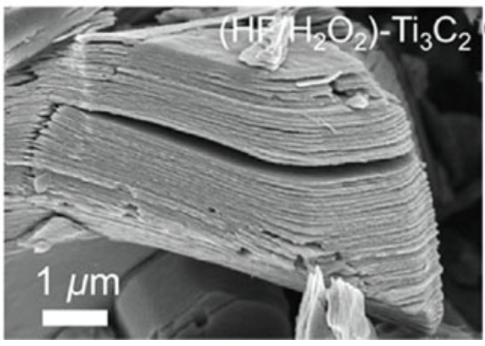
MXenes
A class of 2-D materials
Source: B. Anasori and Y. Gogotsi. 2D Metal Carbides and Nitrides (MXenes) Structure, Properties and Applications. Springer, 06 2019.

Slide 8
MXenes
A class of 2-D materials
Possess diverse set of properties
Source: B. Anasori and Y. Gogotsi. 2D Metal Carbides and Nitrides (MXenes) Structure, Properties and Applications. Springer, 06 2019.

Slide 9
MXenes
A class of 2-D materials
Possess diverse set of properties
Broadest known theoretical chemical
space among 2D materials*
Source: B. Anasori and Y. Gogotsi. 2D Metal Carbides and Nitrides (MXenes) Structure, Properties and Applications. Springer, 06 2019.
*J. Park. ACS Nano, 18(43):29678–29688, 2024. PMID: 39401454.

Slide 10
MXenes
A class of 2-D materials
Possess diverse set of properties
Broadest known theoretical chemical
space among 2D materials*
Have wide range of applications
Flexible optoelectronics
Solar energy conversion
Catalysis
Batteries
Chemical sensing
And many more
Source: B. Anasori and Y. Gogotsi. 2D Metal Carbides and Nitrides (MXenes) Structure, Properties and Applications. Springer, 06 2019.
*J. Park. ACS Nano, 18(43):29678–29688, 2024. PMID: 39401454.
Notes:
* Ripe for ML/DL!

Slide 11
Unfortunately
MXenes are challenging to synthesize
Fewer than 200 MXenes have been synthesized
Physics-based Computational modelling is slow
Takes about a day to calculate a target property for one MXene with DFT
Thus, ML/DL is needed to help guide experimentalists
Our method performs around 1 second to calculate a target property for one MXene
~50,000x faster than DFT

Slide 12
What MXene Properties should we predict?
We talked with more than a dozen MXenes researchers
Compiled a list of “desired” MXene properties

Slide 13
List of “Desired” MXene Properties
Property Name | Property Name (continued)
Band Gap | Magnetic (T/F)
Carrier Density | Metallic (T/F)
Carrier Effective Mass | Optical Absorption Coefficient
Carrier Lifetime | Permeability
Carrier Mobility | Permittivity
Charge Recombination | Poisson’s Ratio
d-Band Center | Reflectivity
Density of States at Fermi Level | Resistivity
Dynamically Stable | Seebeck Coefficient
Elastic Moduli (Bulk, Shear, Young’s) | Sensitivity to Disorder
Elastic Coefficients, c₁₁ and c₁₂ | Termination Binding Energy
Energy above Convex Hull | Thermal Conductivity
Electrical Conductivity | THz Range (Transmission)
Heat of Formation | Transmittance
Hole Effective Mass | Work Function
Lattice Constant
Notes:
Here is a list of material properties that I came up with after extensive discussions with project team members

Slide 14
List of “Desired” MXene Properties
Property Name | Property Name (continued)
Band Gap* | Magnetic (T/F)*
Carrier Density | Metallic (T/F)
Carrier Effective Mass | Optical Absorption Coefficient
Carrier Lifetime | Permeability
Carrier Mobility | Permittivity
Charge Recombination | Poisson’s Ratio*
d-Band Center* | Reflectivity
Density of States at Fermi Level* | Resistivity
Dynamically Stable* | Seebeck Coefficient
Elastic Moduli (Bulk, Shear, Young’s)* | Sensitivity to Disorder
Elastic Coefficients, c₁₁ and c₁₂* | Termination Binding Energy*
Electrical Conductivity | Thermal Conductivity
Energy above Convex Hull* | THz Range (Transmission)
Heat of Formation* | Transmittance
Hole Effective Mass | Work Function*
Lattice Constant*
* Indicates sufficient training data found
Notes:
Here is a list of material properties that I came up with after extensive discussions with project team members

Slide 15
Quick Summary of Phases
More details later!

Slide 16
Phase 0: Predicting MXene Properties via ML
Our work described in this chapter is published in the IEEE ICMLA-2022 conference proceedings

Slide 17
Phase 0: Predicting MXene Properties via ML
Our work described in this chapter is published in the IEEE ICMLA-2022 conference proceedings
We investigate standard machine learning models to predict MXene properties using only basic atomic information of a MXene

Slide 18
Phase 0: Predicting MXene Properties via ML
Our work described in this chapter is published in the IEEE ICMLA-2022 conference proceedings
We investigate standard machine learning models to predict MXene properties using only basic atomic information of a MXene
The model performance was not terrible, but it caused us to look for more complex models

Slide 19
Phase 1: Graph Contrastive Learning
Our work described in this chapter is published in IEEE NAP-2024

Slide 20
Phase 1: Graph Contrastive Learning
Our work described in this chapter is published in IEEE NAP-2024
We trained models through Graph Contrastive Learning (GCL), a type of Graph Neural Network-based deep learning algorithm, to predict MXene properties

Slide 21
Phase 1: Graph Contrastive Learning
Our work described in this chapter is published in IEEE NAP-2024
We trained models through Graph Contrastive Learning (GCL), a type of Graph Neural Network-based deep learning algorithm, to predict MXene properties
GCL models performed better than standard ML models

Slide 22
Phase 1: Graph Contrastive Learning
Our work described in this chapter is published in IEEE NAP-2024
We trained models through Graph Contrastive Learning (GCL), a type of Graph Neural Network-based deep learning algorithm, to predict MXene properties
GCL models performed better than standard ML models
However, require a MXene’s crystal structure information as input
Drawback, since MXene graph structure information typically requires computationally expensive Density Functional Theory predictions

Slide 23
Phase 1: Graph Contrastive Learning
Our work described in this chapter is published in IEEE NAP-2024
We trained models through Graph Contrastive Learning (GCL), a type of Graph Neural Network-based deep learning algorithm, to predict MXene properties
GCL models performed better than standard ML models
However, require a MXene’s crystal structure information as input
Drawback, since MXene graph structure information typically requires computationally expensive Density Functional Theory predictions
We continued to look for more accurate types of graph based models.

Slide 24
Phase 2: Atomistic Line Graph Neural Networks
Our work in this chapter is accepted for publication for IEEE ICAD 2025
We train Atomistic Line Graph Neural Network (ALIGNNTL)-based models to predict MXene properties when given a MXene’s crystal structure information.
These models performed better than the models from Phase 0 and Phase 1.

Slide 25
Phase 2: Atomistic Line Graph Neural Networks
Our work in this chapter is accepted for publication for IEEE ICAD 2025

Slide 26
Phase 2: Atomistic Line Graph Neural Networks
Our work in this chapter is accepted for publication for IEEE ICAD 2025
We train Atomistic Line Graph Neural Network (ALIGNNTL)-based models to predict MXene properties when given a MXene’s crystal structure information.

Slide 27
Phase 2: Atomistic Line Graph Neural Networks
Our work in this chapter is accepted for publication for IEEE ICAD 2025
We train Atomistic Line Graph Neural Network (ALIGNNTL)-based models to predict MXene properties when given a MXene’s crystal structure information.
These models performed better than the models from Phase 0 and Phase 1.

Slide 28
Phase 3: Generating MXene Graphs
Our work in this phase has been submitted to the 2025 IEEE NAP conference (same paper as Phase 4)

Slide 29
Phase 3: Generating MXene Graphs
Our work in this phase has been submitted to the 2025 IEEE NAP conference (same paper as Phase 4)
We develop a novel rules-based algorithm to generate chemically accurate

Slide 30
Phase 3: Generating MXene Graphs
Our work in this phase has been submitted to the 2025 IEEE NAP conference (same paper as Phase 4)
We develop a novel rules-based algorithm to generate chemically accurate
Mxene crystal structures in .cif file format

Slide 31
Phase 3: Generating MXene Graphs
Our work in this phase has been submitted to the 2025 IEEE NAP conference (same paper as Phase 4)
We develop a novel rules-based algorithm to generate chemically accurate
Mxene crystal structures in .cif file format
We use this algorithm to generate 13 million unique MXenes, 99.6% of which were predicted to be at least marginally stable by predictions for Heat of Formation or Dynamic Stability (T/F)

Slide 32
Phase 4: High-throughput Deep Learning for MXene Property Prediction
Our work in this phase has been submitted to the 2025 IEEE NAP conference (same paper as Phase 3)

Slide 33
Phase 4: High-throughput Deep Learning for MXene Property Prediction
Our work in this phase has been submitted to the 2025 IEEE NAP conference (same paper as Phase 3)
We retrain the ALIGNNTL-based models from Phase 2 on larger training datasets to predict 9 MXene target properties when given a MXene’s crystal structure information:
Band Gap, Bulk Modulus, dBand Center, Density of States (at Fermi Level), Dynamically Stable (T/F), Heat of Formation, Magnetic (T/F), Termination Binding Energy, and Work Function
Finally, we predict these target properties for each of the 13 million MXenes generated in Phase 3
To our knowledge, this is the largest publicly-available dataset of MXenes properties to date

Slide 34
Phase 4: High-throughput Deep Learning for MXene Property Prediction
Our work in this phase has been submitted to the 2025 IEEE NAP conference (same paper as Phase 3)
We retrain the ALIGNNTL-based models from Phase 2 on larger training datasets to predict 9 MXene target properties when given a MXene’s crystal structure information:

Slide 35
Phase 4: High-throughput Deep Learning for MXene Property Prediction
Our work in this phase has been submitted to the 2025 IEEE NAP conference (same paper as Phase 3)
We retrain the ALIGNNTL-based models from Phase 2 on larger training datasets to predict 9 MXene target properties when given a MXene’s crystal structure information:
Band Gap, Bulk Modulus, dBand Center, Density of States (at Fermi Level), Dynamically Stable (T/F), Heat of Formation, Magnetic (T/F), Termination Binding Energy, and Work Function
Finally, we predict these target properties for each of the 13 million MXenes generated in Phase 3

Slide 36
Phase 4: High-throughput Deep Learning for MXene Property Prediction
Our work in this phase has been submitted to the 2025 IEEE NAP conference (same paper as Phase 3)
We retrain the ALIGNNTL-based models from Phase 2 on larger training datasets to predict 9 MXene target properties when given a MXene’s crystal structure information:
Band Gap, Bulk Modulus, dBand Center, Density of States (at Fermi Level), Dynamically Stable (T/F), Heat of Formation, Magnetic (T/F), Termination Binding Energy, and Work Function
Finally, we predict these target properties for each of the 13 million MXenes generated in Phase 3
To our knowledge, this is the largest publicly-available dataset of MXenes properties to date

Slide 37
More detailed summary of Phases

Slide 38
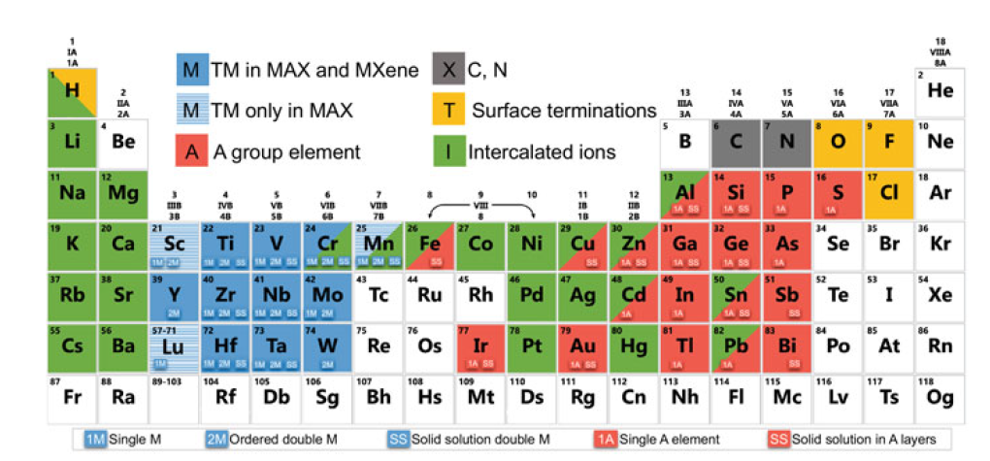
Background
MXenes take the form M_{n+1}X_{n}T_{x}
M is an early transition metal
X is carbon and/or nitrogen
T_{x} is the surface termination
n is 1-9
Source: [3]

Slide 39
Related work
Multiple prior works design ML methods which predict properties of various classes of materials when given tabular data as input [5], [14], [15]
Unfortunately, to our knowledge, most existing ML methods for MXene property prediction are unable to handle graph data
Prior ML models do not take into account the graphical structure of MXene molecules
This limits the generalizability of prior machine learning model predictions beyond specialized subclasses of MXenes

Slide 40
Why do we need ML/DL?
MXene synthesis remains costly and time-consuming [6]
DFT: accurate but too slow for high-throughput predictions [11]
Acquiring MXenes training data is difficult!
Transfer learning helps when desired target that has small dataset [30]
Issues with standard ML techniques
Fail to capture graph structure information
Difficult to incorporate transfer learning
Not sufficiently accurate

Slide 41
Phase 0: Predicting MXene Properties via ML
Our work described in this chapter is published in the IEEE ICMLA-2022 conference proceedings
We investigate standard machine learning models to predict MXene properties using only basic atomic information of a MXene
The model performance was not terrible, but it caused us to look for more complex models

Slide 42
ML MXene Prediction Results from [7]
Target Property | Random Forest | Random Forest SPCA | XGBoost | XGBoost SPCA
Work Function | 0.532 eV | 0.929 eV | 0.308 eV | 0.606 eV
Heat of Formation | 0.362 eV/atom | 0.647 eV/atom | 0.128 eV/atom | 0.365 eV/atom
Fermi Level | 0.959 eV | 1.337 eV | 0.460 eV | 0.791 eV
Density of States (at Fermi Level) | 2.015 states/(eV * unit cell) | 2.132 states/(eV * unit cell) | 1.984 states/(eV * unit cell) | 2.084 states/(eV * unit cell)
Magnetic | 87.1% | 88.2% | 89.7% | 83.8%
RMSE for all but Magnetic
Magnetic uses accuracy
Notes:
eV stands for electron volts, or 1.6 * 10^-19 J
SPCA has slightly worse RMSE, but more interpretable
XGBoost outperformed random forest for all of the features

Slide 43
Phase 1: Graph Contrastive Learning
Our work described in this chapter is published in IEEE NAP-2024
We trained models through Graph Contrastive Learning (GCL), a type of Graph Neural Network-based deep learning algorithm, to predict MXene properties
GCL models performed better than standard ML models
However, require a MXene’s crystal structure information as input
Drawback, since MXene graph structure information typically requires computationally expensive Density Functional Theory predictions
We continued to look for more accurate types of graph based models.

Slide 44
Molecular Graphs
Molecular graphs include the following information:
Nodes contain atomic-level features that specify properties about the corresponding atoms
Edges contain bond-level features that specify properties about the corresponding bonds
Global features specify molecule-level properties for the material
Adjacency information lists the other atoms to which each atom bonds
Converting and combining all node-level, edge-level, molecule-level, and adjacency information data into tabular data remains difficult

Slide 45
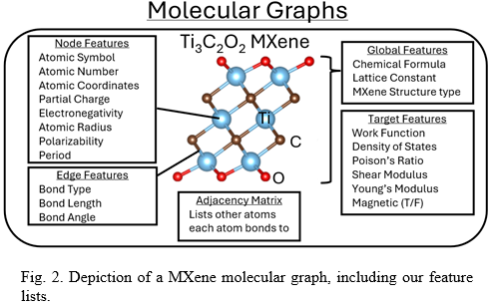
MXene Molecular Graph

Slide 46
Graphs vs Tabular Data
Existing ML methods for MXene property prediction require tabular data – not molecular graph data
Graphs allow more efficient information representation than tabular data
Encode important structural information not captured by tabular data
Graph Neural Networks (GNNs)
Type of neural network which takes graph data as input
Offer a flexible, tunable architecture for material property prediction
P. Reiser et al. Commun Mater 3, 93 (2022).
Y. Zhu, Y. Xu, Q. Liu, and S. Wu. arXiv:2109.01116, 2021.

Slide 47
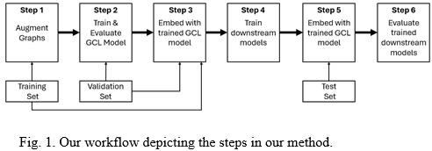
Workflow

Slide 48
Graphical Neural Networks (GNNs)
GNNs are a class of neural networks for processing data that can be represented as graphs
Key design element of GNNs: pairwise message passing
Graph nodes iteratively update their representations by exchanging information with their neighbors
L. Wu, P. Cui, J. Pei, L. Zhao, X. Guo. Proc. 29th ACM SIGKDD, pp. 5831-5832, 2023.

Slide 49
Graph Contrastive Learning (GCL)
Type of GNN method that has been widely applied in other domains
Uses data augmentation to learn more robust graph representations
GCL aims to maximize agreement between augmentations to learn invariant, discriminative representations in an unsupervised manner
Specifically, we use VICReg-based GCL models
Y. Zhu, Y. Xu, F. Yu, Q. Liu, S. Wu, L. Wang. In WWW, pages 2069–2080, 2021.
N. Liu, X.Wang, D. Bo, C. Shi, J. Pei. NeurIPS 215, 2972 – 2983, 2022.
A. Bardes, J. Ponce, Y. LeCun. arXiv preprint arXiv:2105.04906 (2021).

Slide 50
VICReg loss function
Contains three terms:
Invariance, Variance, and Covariance
A. Bardes, J. Ponce, Y. LeCun. arXiv preprint arXiv:2105.04906 (2021).

Slide 51
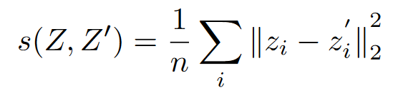
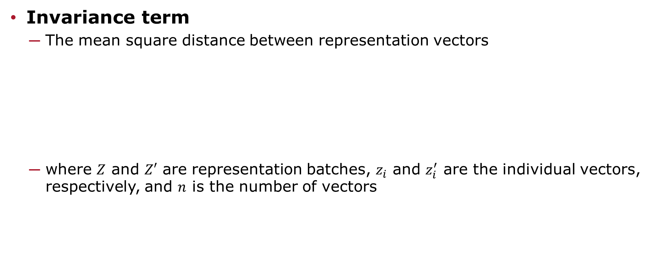
VICReg loss function
Invariance term
The mean square distance between representation vectors
where $Z$ and $Z′$ are representation batches, $z_{i}$ and $z_{i}^{′}$ are the individual vectors, respectively, and $n$ is the number of vectors
A. Bardes, J. Ponce, Y. LeCun. arXiv preprint arXiv:2105.04906 (2021).

Slide 52
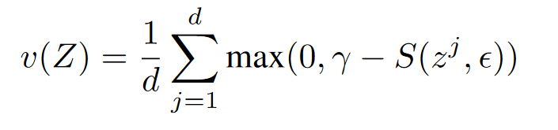

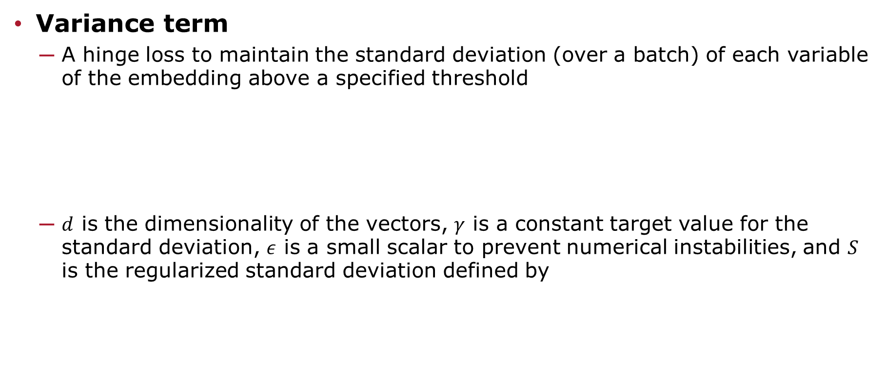
VICReg loss function
Variance term
A hinge loss to maintain the standard deviation (over a batch) of each variable of the embedding above a specified threshold
$d$ is the dimensionality of the vectors, $γ$ is a constant target value for the standard deviation, $ε$ is a small scalar to prevent numerical instabilities, and $S$ is the regularized standard deviation defined by
A. Bardes, J. Ponce, Y. LeCun. arXiv preprint arXiv:2105.04906 (2021).

Slide 53
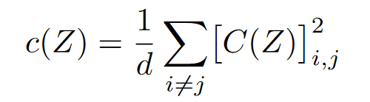
VICReg loss function
Covariance term
Shrinks the non-diagonal entries of the covariance matrix between all pairs of embedding variables toward zero
Prevents informational collapse
C(Z) is the covariance matrix
A. Bardes, J. Ponce, Y. LeCun. arXiv preprint arXiv:2105.04906 (2021).

Slide 54
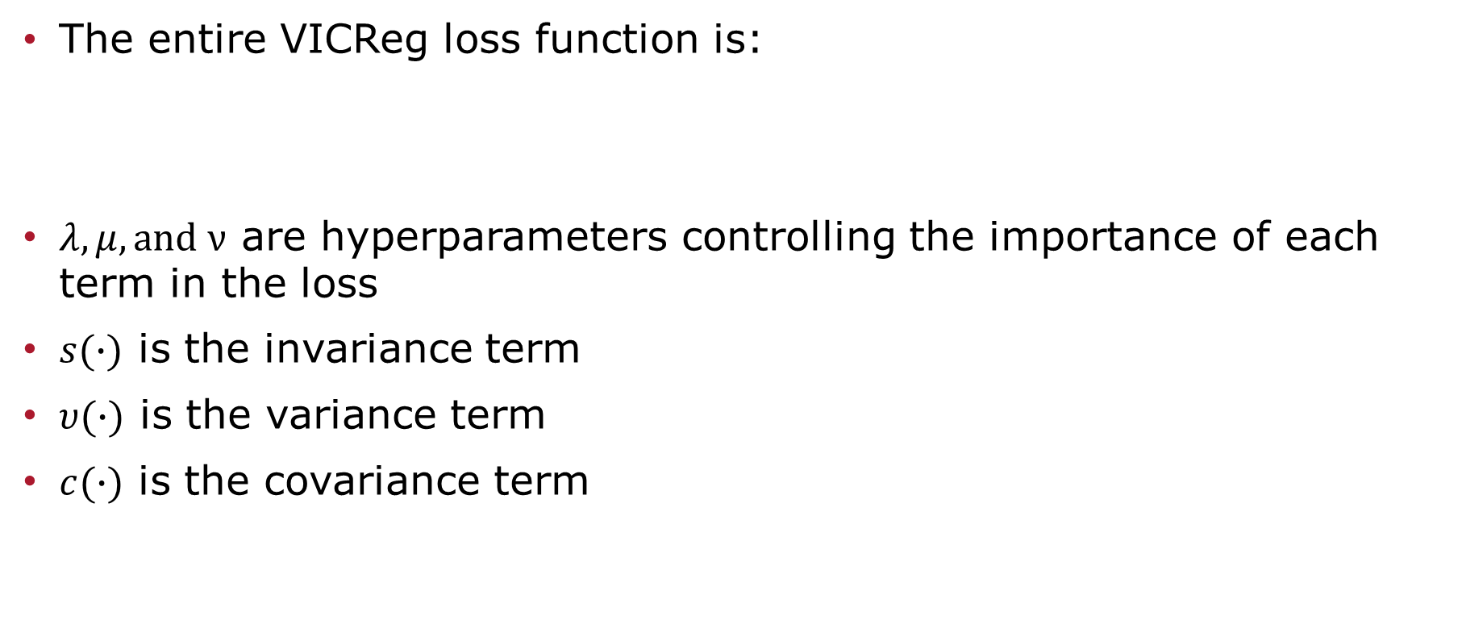
VICReg loss function
The entire VICReg loss function is:
$λ, μ, and ν$ are hyperparameters controlling the importance of each term in the loss
$s(∙)$ is the invariance term
$υ(∙)$ is the variance term
$c(∙)$ is the covariance term
A. Bardes, J. Ponce, Y. LeCun. arXiv preprint arXiv:2105.04906 (2021).

Slide 55
MXenes Best model for each feature
Target Property | Downstream Model | Augmentation Set | RMSE
Bulk Modulus | Linear Regression | 240 | 21.65 ± 2.849
Density of States at Fermi Level | Linear Regression | 20 | 0.52 ± 0.057
Poisson’s Ratio | Random Forest | 20 | 0.067 ± 0.015
Shear Modulus | Linear Regression | 134 | 14.56 ± 2.336
Work Function | XGBoost | 120 | 0.42 ± 0.06
Young’s Modulus | Linear Regression | 23 | 35.67 ± 3.951

Slide 56
Phase 2: Atomistic Line Graph Neural Networks
Our work in this chapter is accepted for publication for IEEE ICAD 2025
We train Atomistic Line Graph Neural Network (ALIGNNTL)-based models to predict MXene properties when given a MXene’s crystal structure information.
These models performed better than the models from Phase 0 and Phase 1.

Slide 57
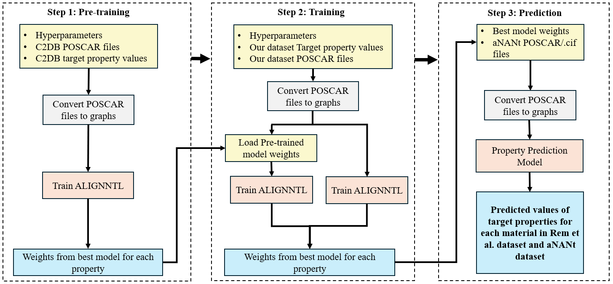
Workflow for Phase 2

Slide 58
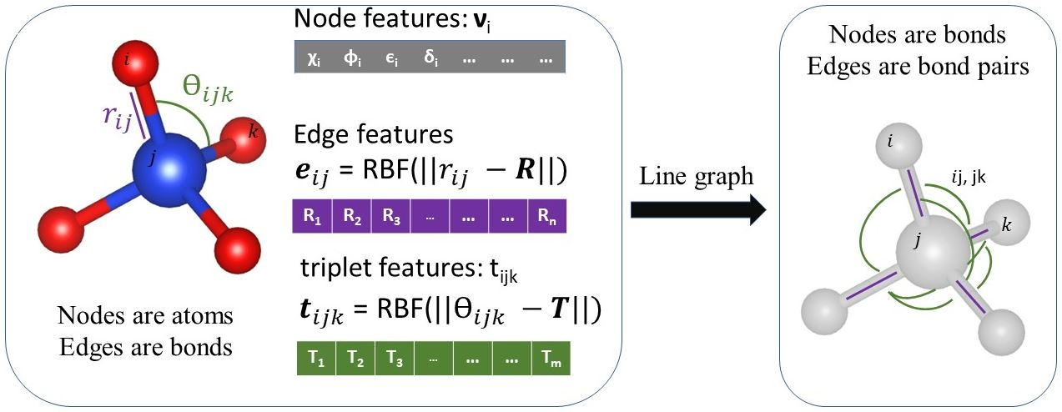
Atomistic Line Graph Neural Network (ALIGNN) [4]
Composes two edge-gated graph convolution layers, applied to:
Atomistic line graph L(g) (representing triplet interactions)
Atomistic bond graph g (representing pair interactions)
[4]

Slide 59
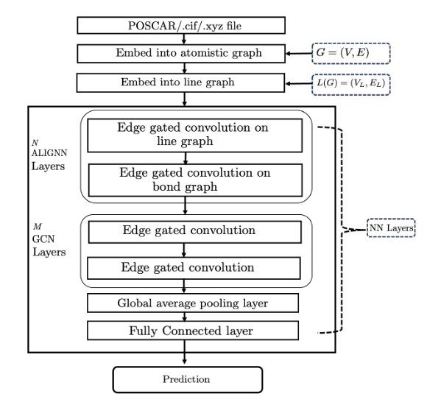
ALIGNNTL NN Architecture

Slide 60
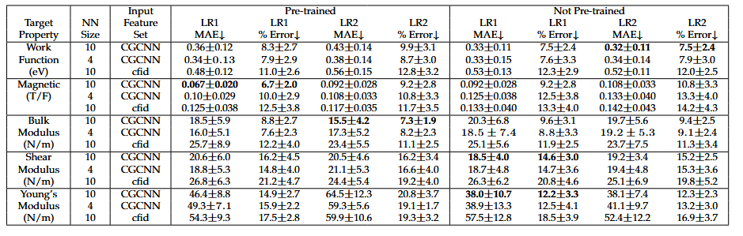
Results

Slide 61
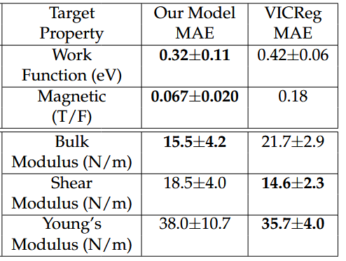
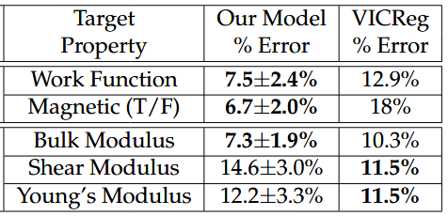
Best Results vs. Phase 1 Results

Slide 62
Phase 3: Generating MXene Graphs
Our work in this phase has been submitted to the 2025 IEEE NAP conference (same paper as Phase 4)
We develop a novel rules-based algorithm to generate chemically accurate
Mxene crystal structures in .cif file format
We use this algorithm to generate 13 million unique MXenes, 99.6% of which were predicted to be at least marginally stable by predictions for Heat of Formation or Dynamic Stability (T/F)

Slide 63
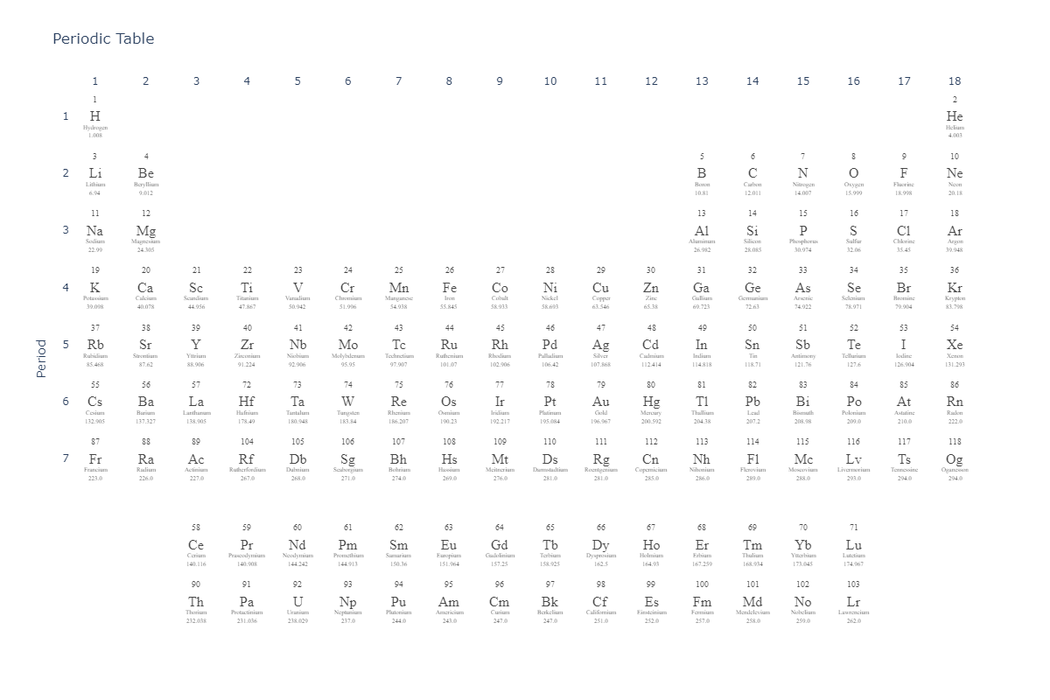
Periodic Table

Slide 64
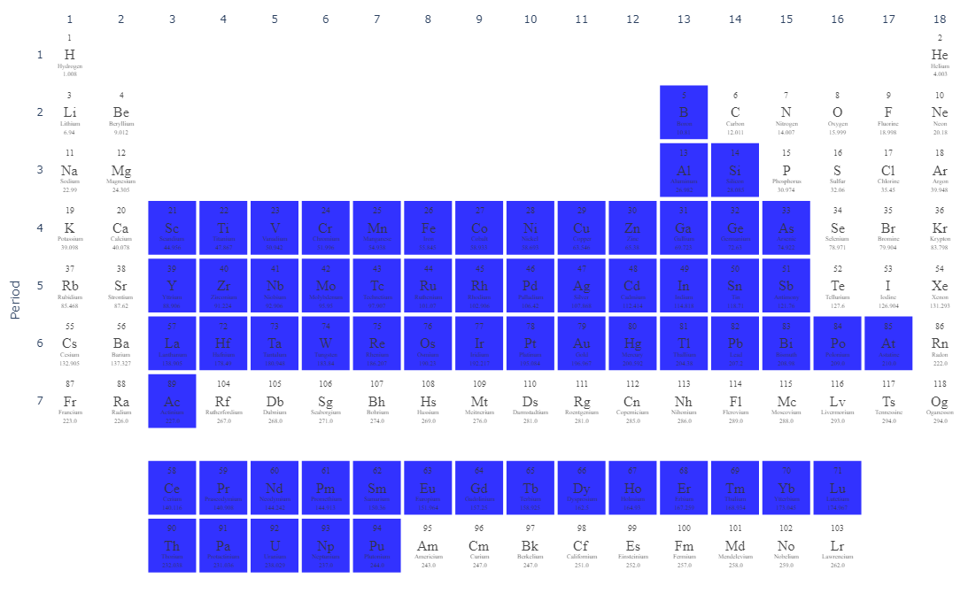
M atoms

Slide 65
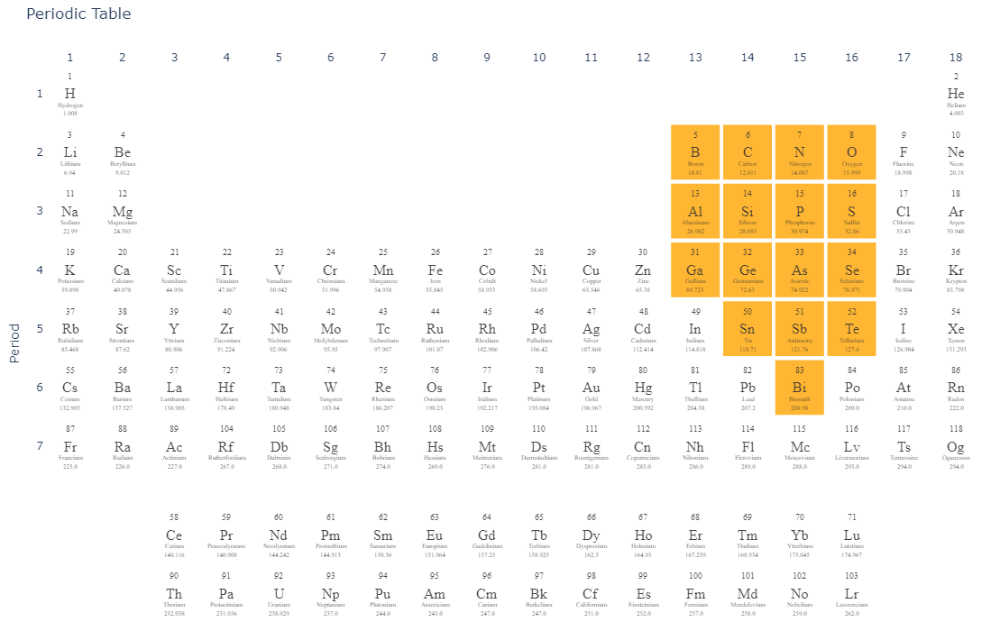
X atoms

Slide 66
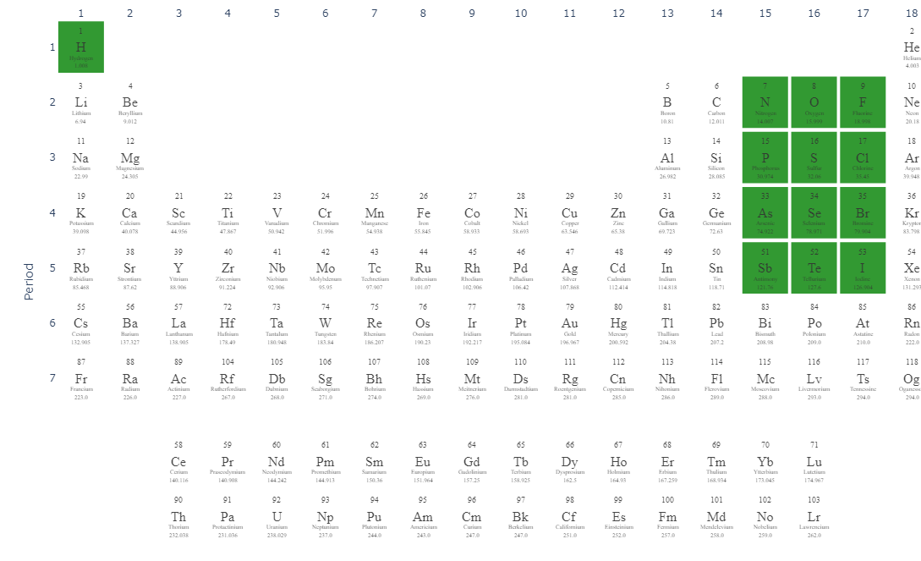
Tx

Slide 67
MXene Sample Space Enumeration
n = 9
M = 64
X = 16
Tx = 39
# Structure types = 10
A simplified sample space with these possibilities consists of:
90 BILLION MXenes!!!!
And this is vastly simplified!

Slide 68
Reducing this sample space
We sample a subset of these 90 billion MXenes

Slide 69
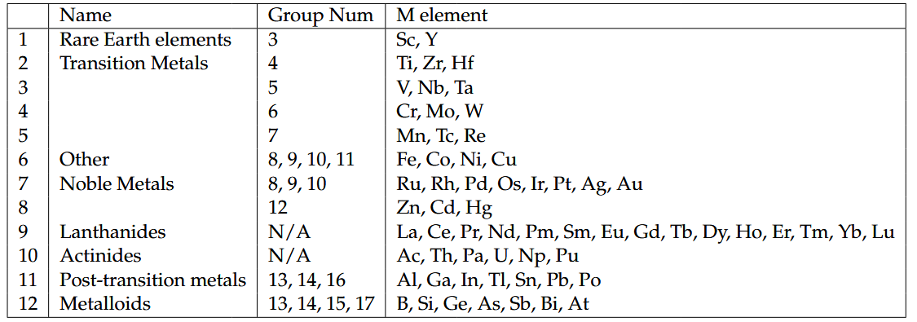
Possible M Elements

Slide 70
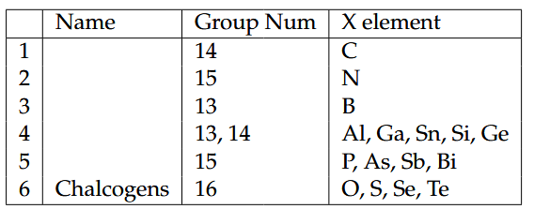
Possible X Elements

Slide 71
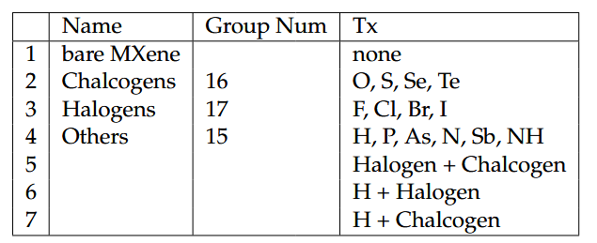
Possible Tx

Slide 72
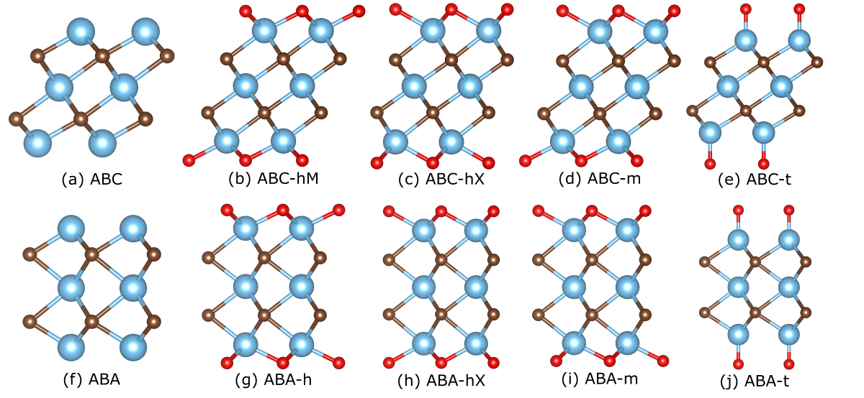
10 MXene Structure types

Slide 73
10 MXene Structure types

Slide 74
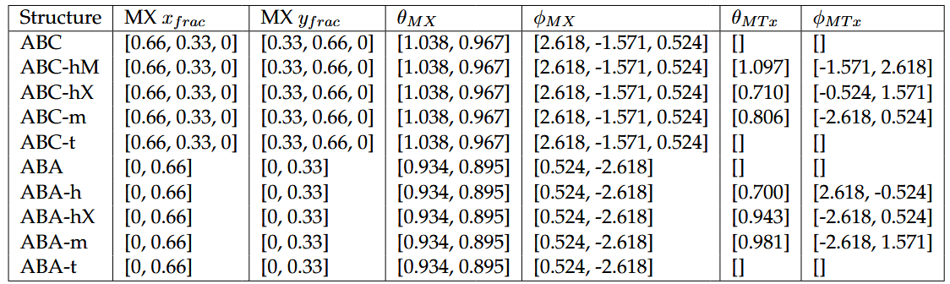
Building a MXene

Slide 75
Phase 4: High-throughput Deep Learning for MXene Property Prediction
Our work in this phase has been submitted to the 2025 IEEE NAP conference (same paper as Phase 3)
We retrain the ALIGNNTL-based models from Phase 2 on larger training datasets to predict MXene 9 MXene target properties when given a MXene’s crystal structure information:
Band Gap, Bulk Modulus, dBand Center, Density of States (at Fermi Level), Dynamically Stable (T/F), Heat of Formation, Magnetic (T/F), Termination Binding Energy, and Work Function
Finally, we predict these target properties for each of the 13 million MXenes generated in Phase 3.
To our knowledge, this is the largest publicly-available dataset of MXenes properties to date.

Slide 76
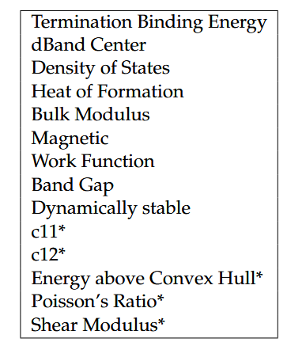
Target Properties
*Not accurate enough

Slide 77
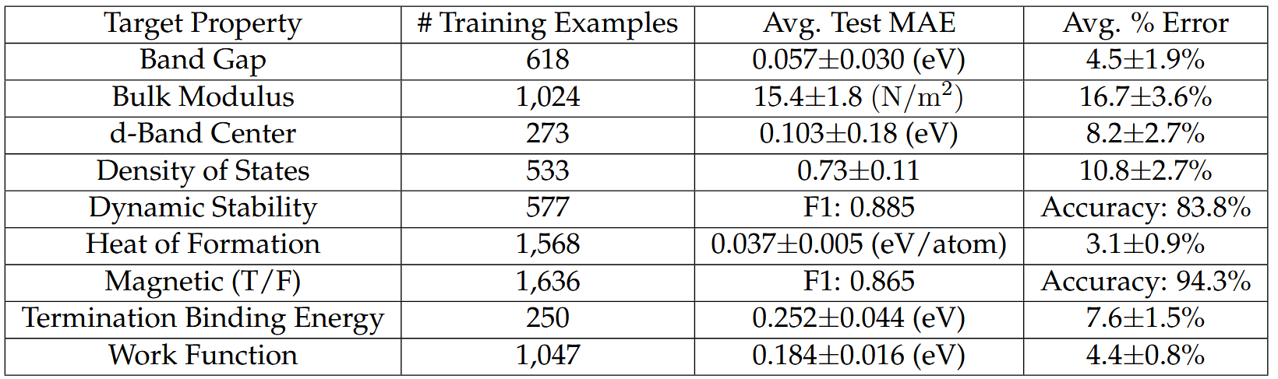
Model Training Results

Slide 78
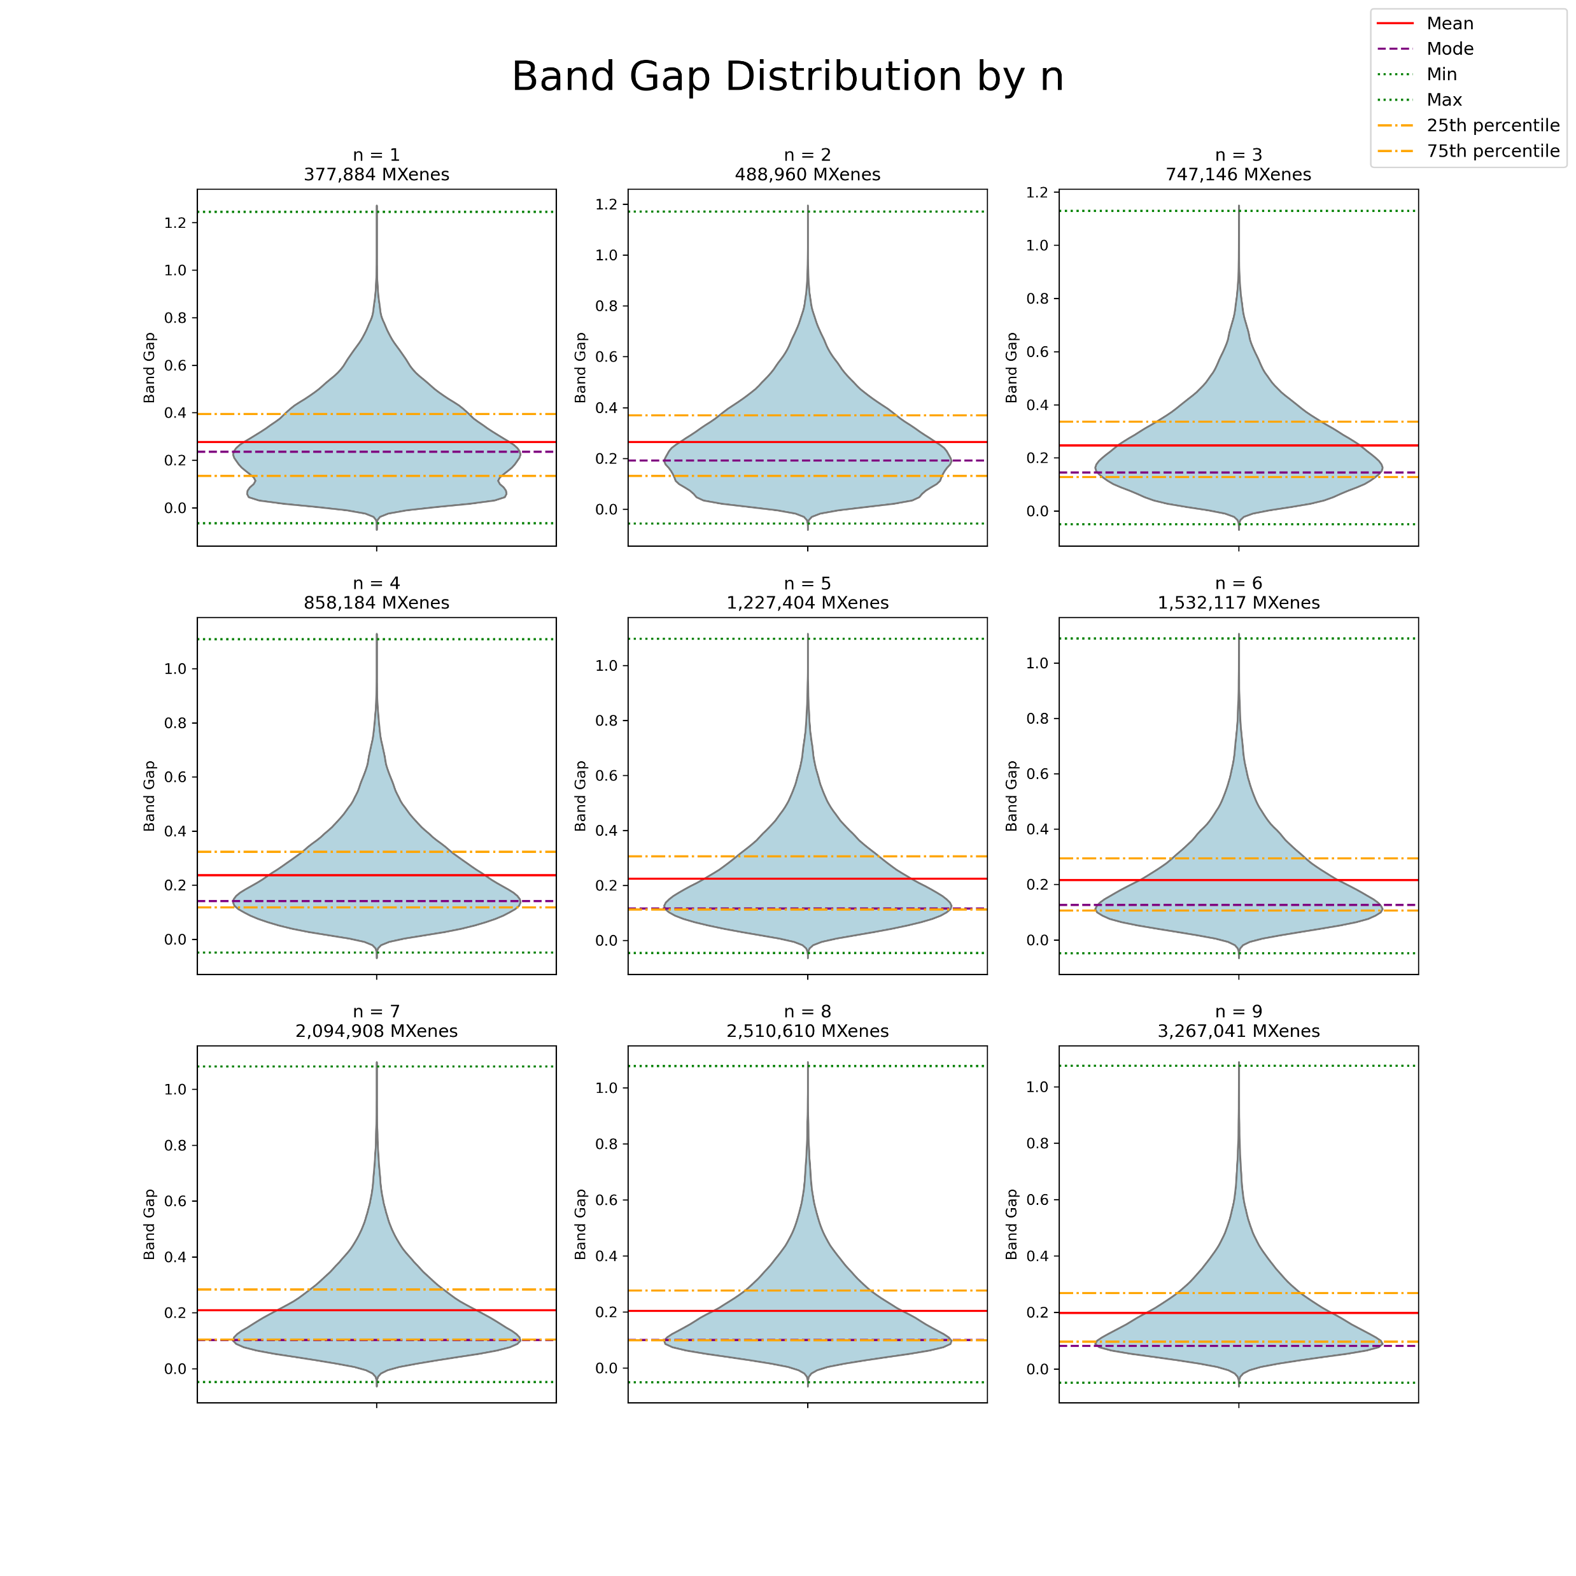
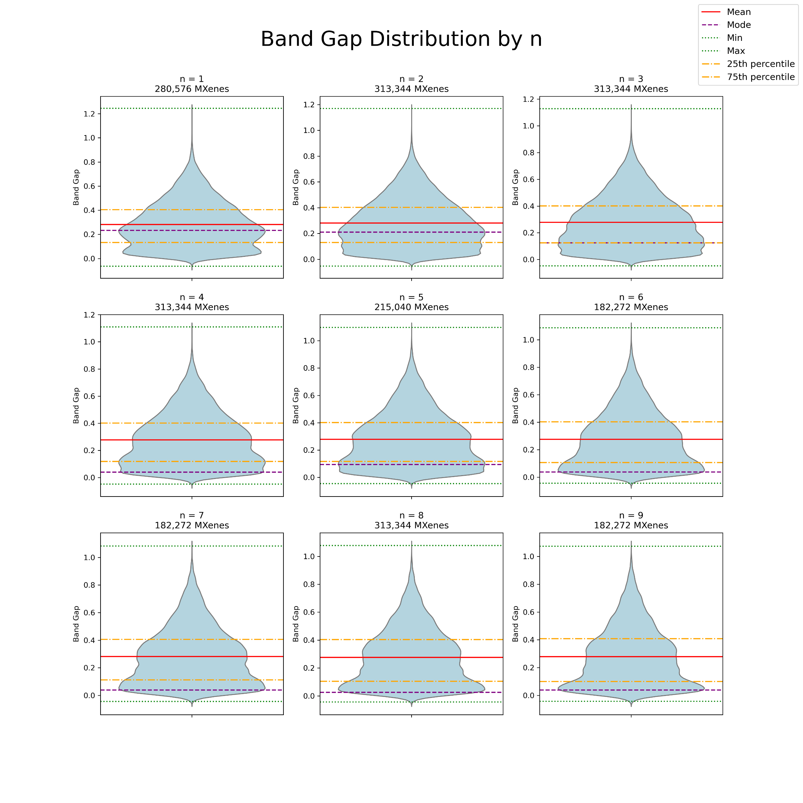

Slide 79
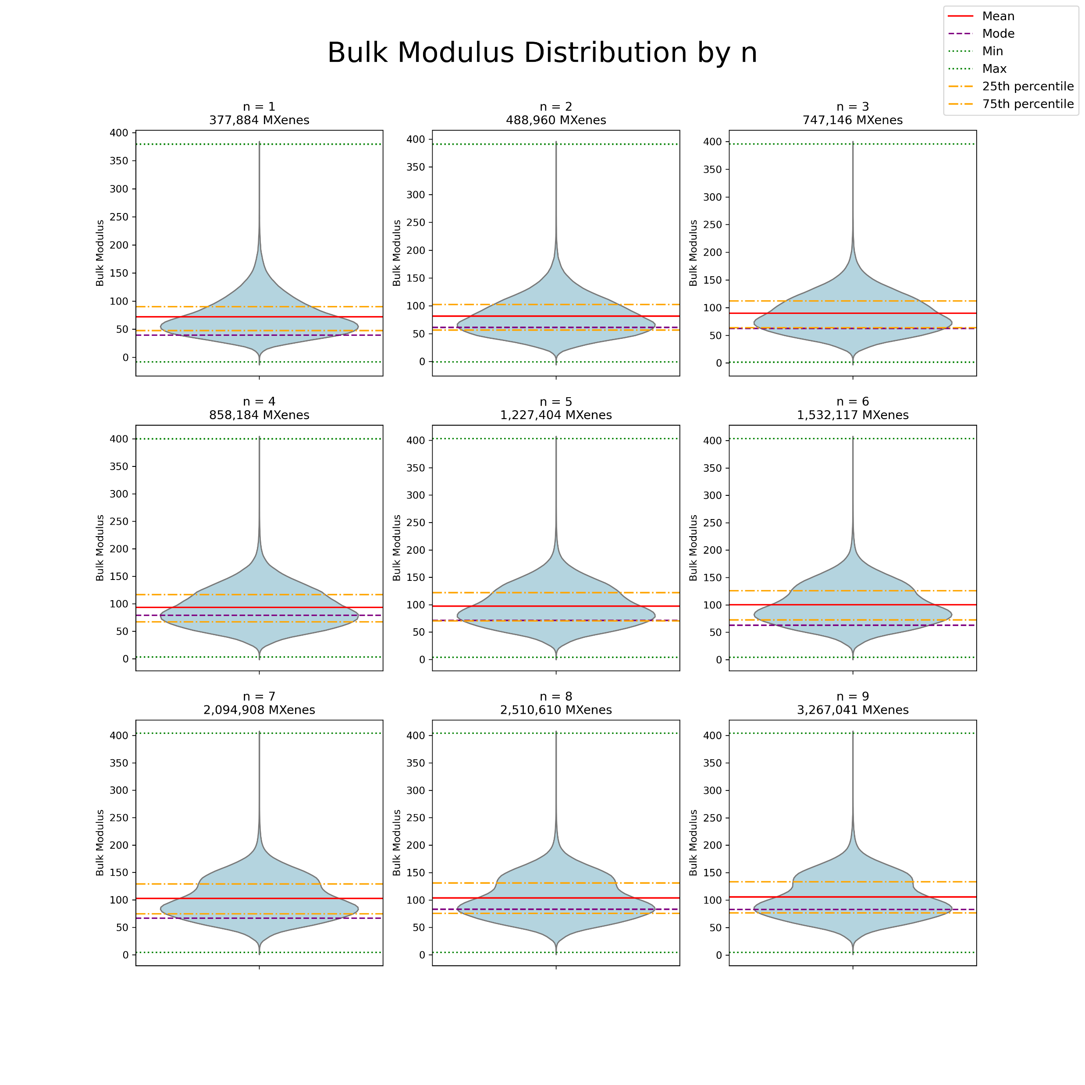
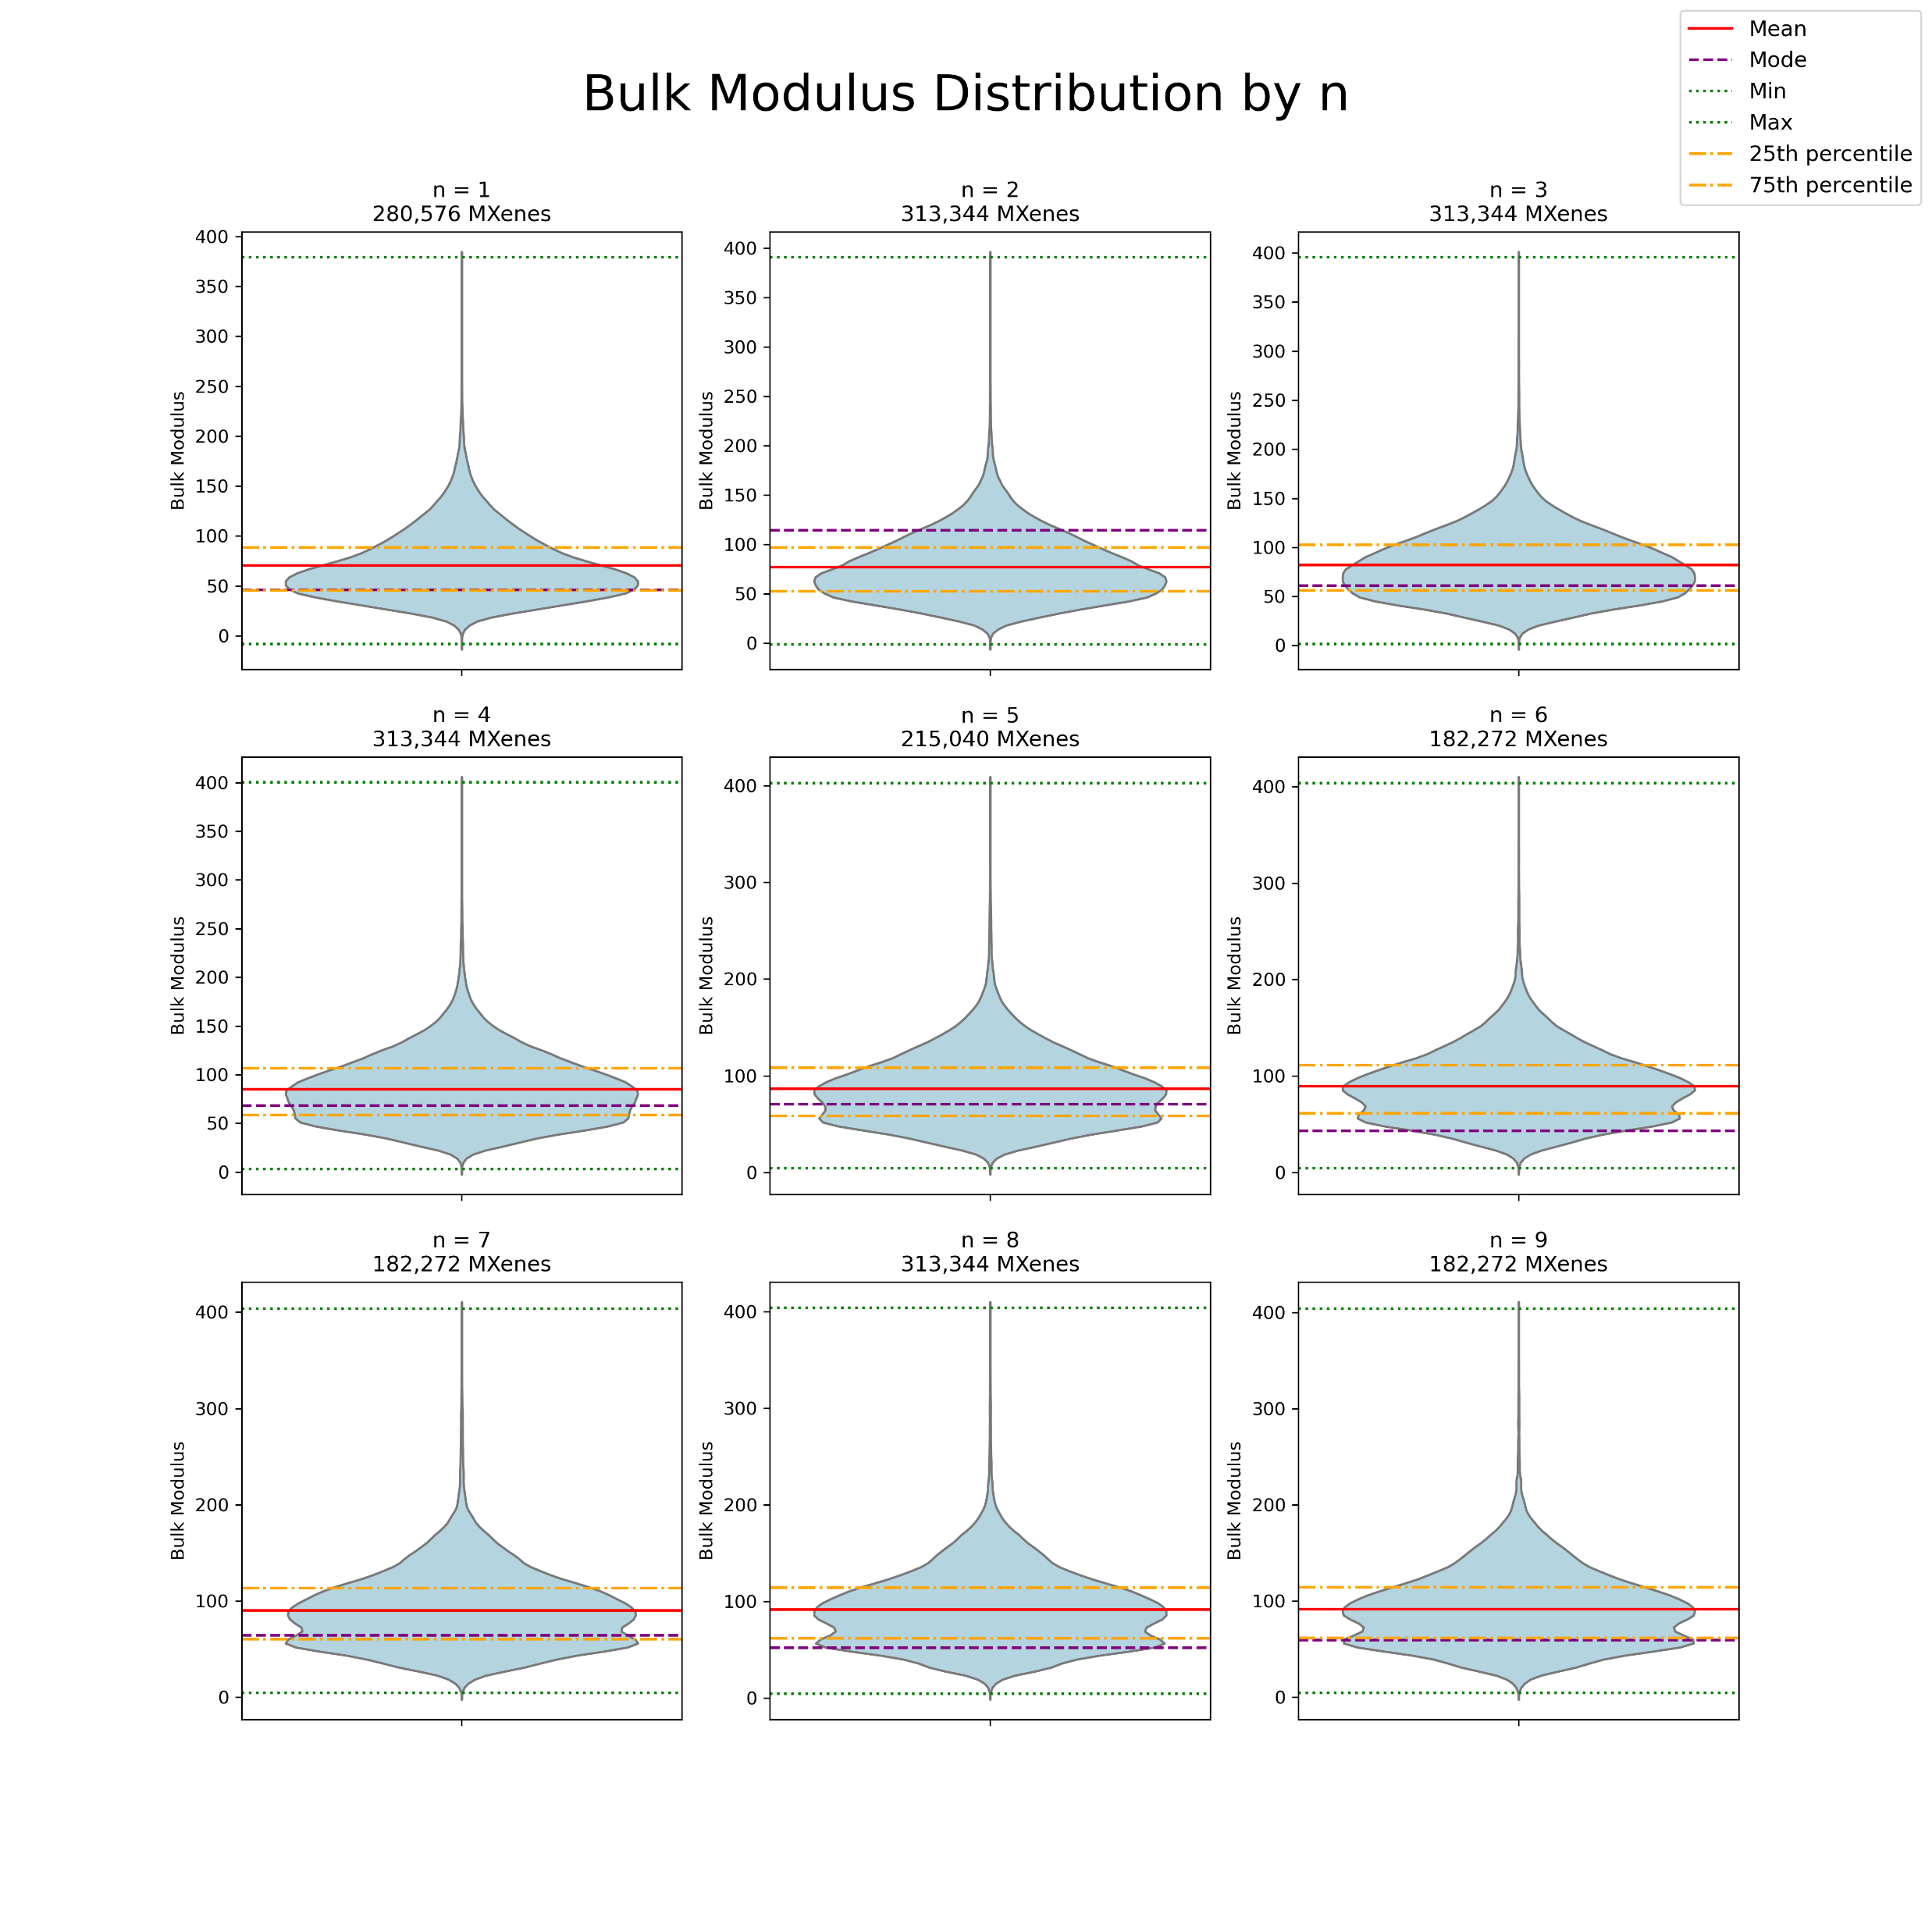

Slide 80
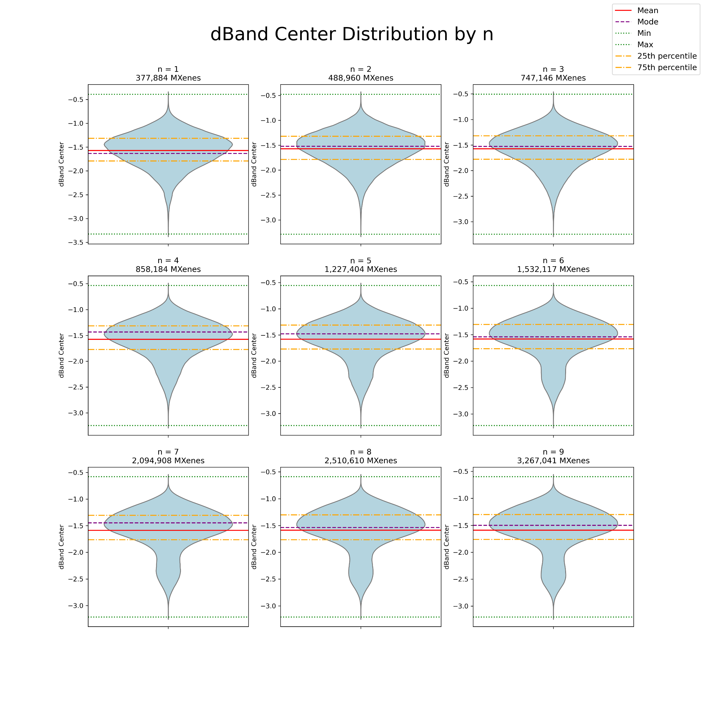
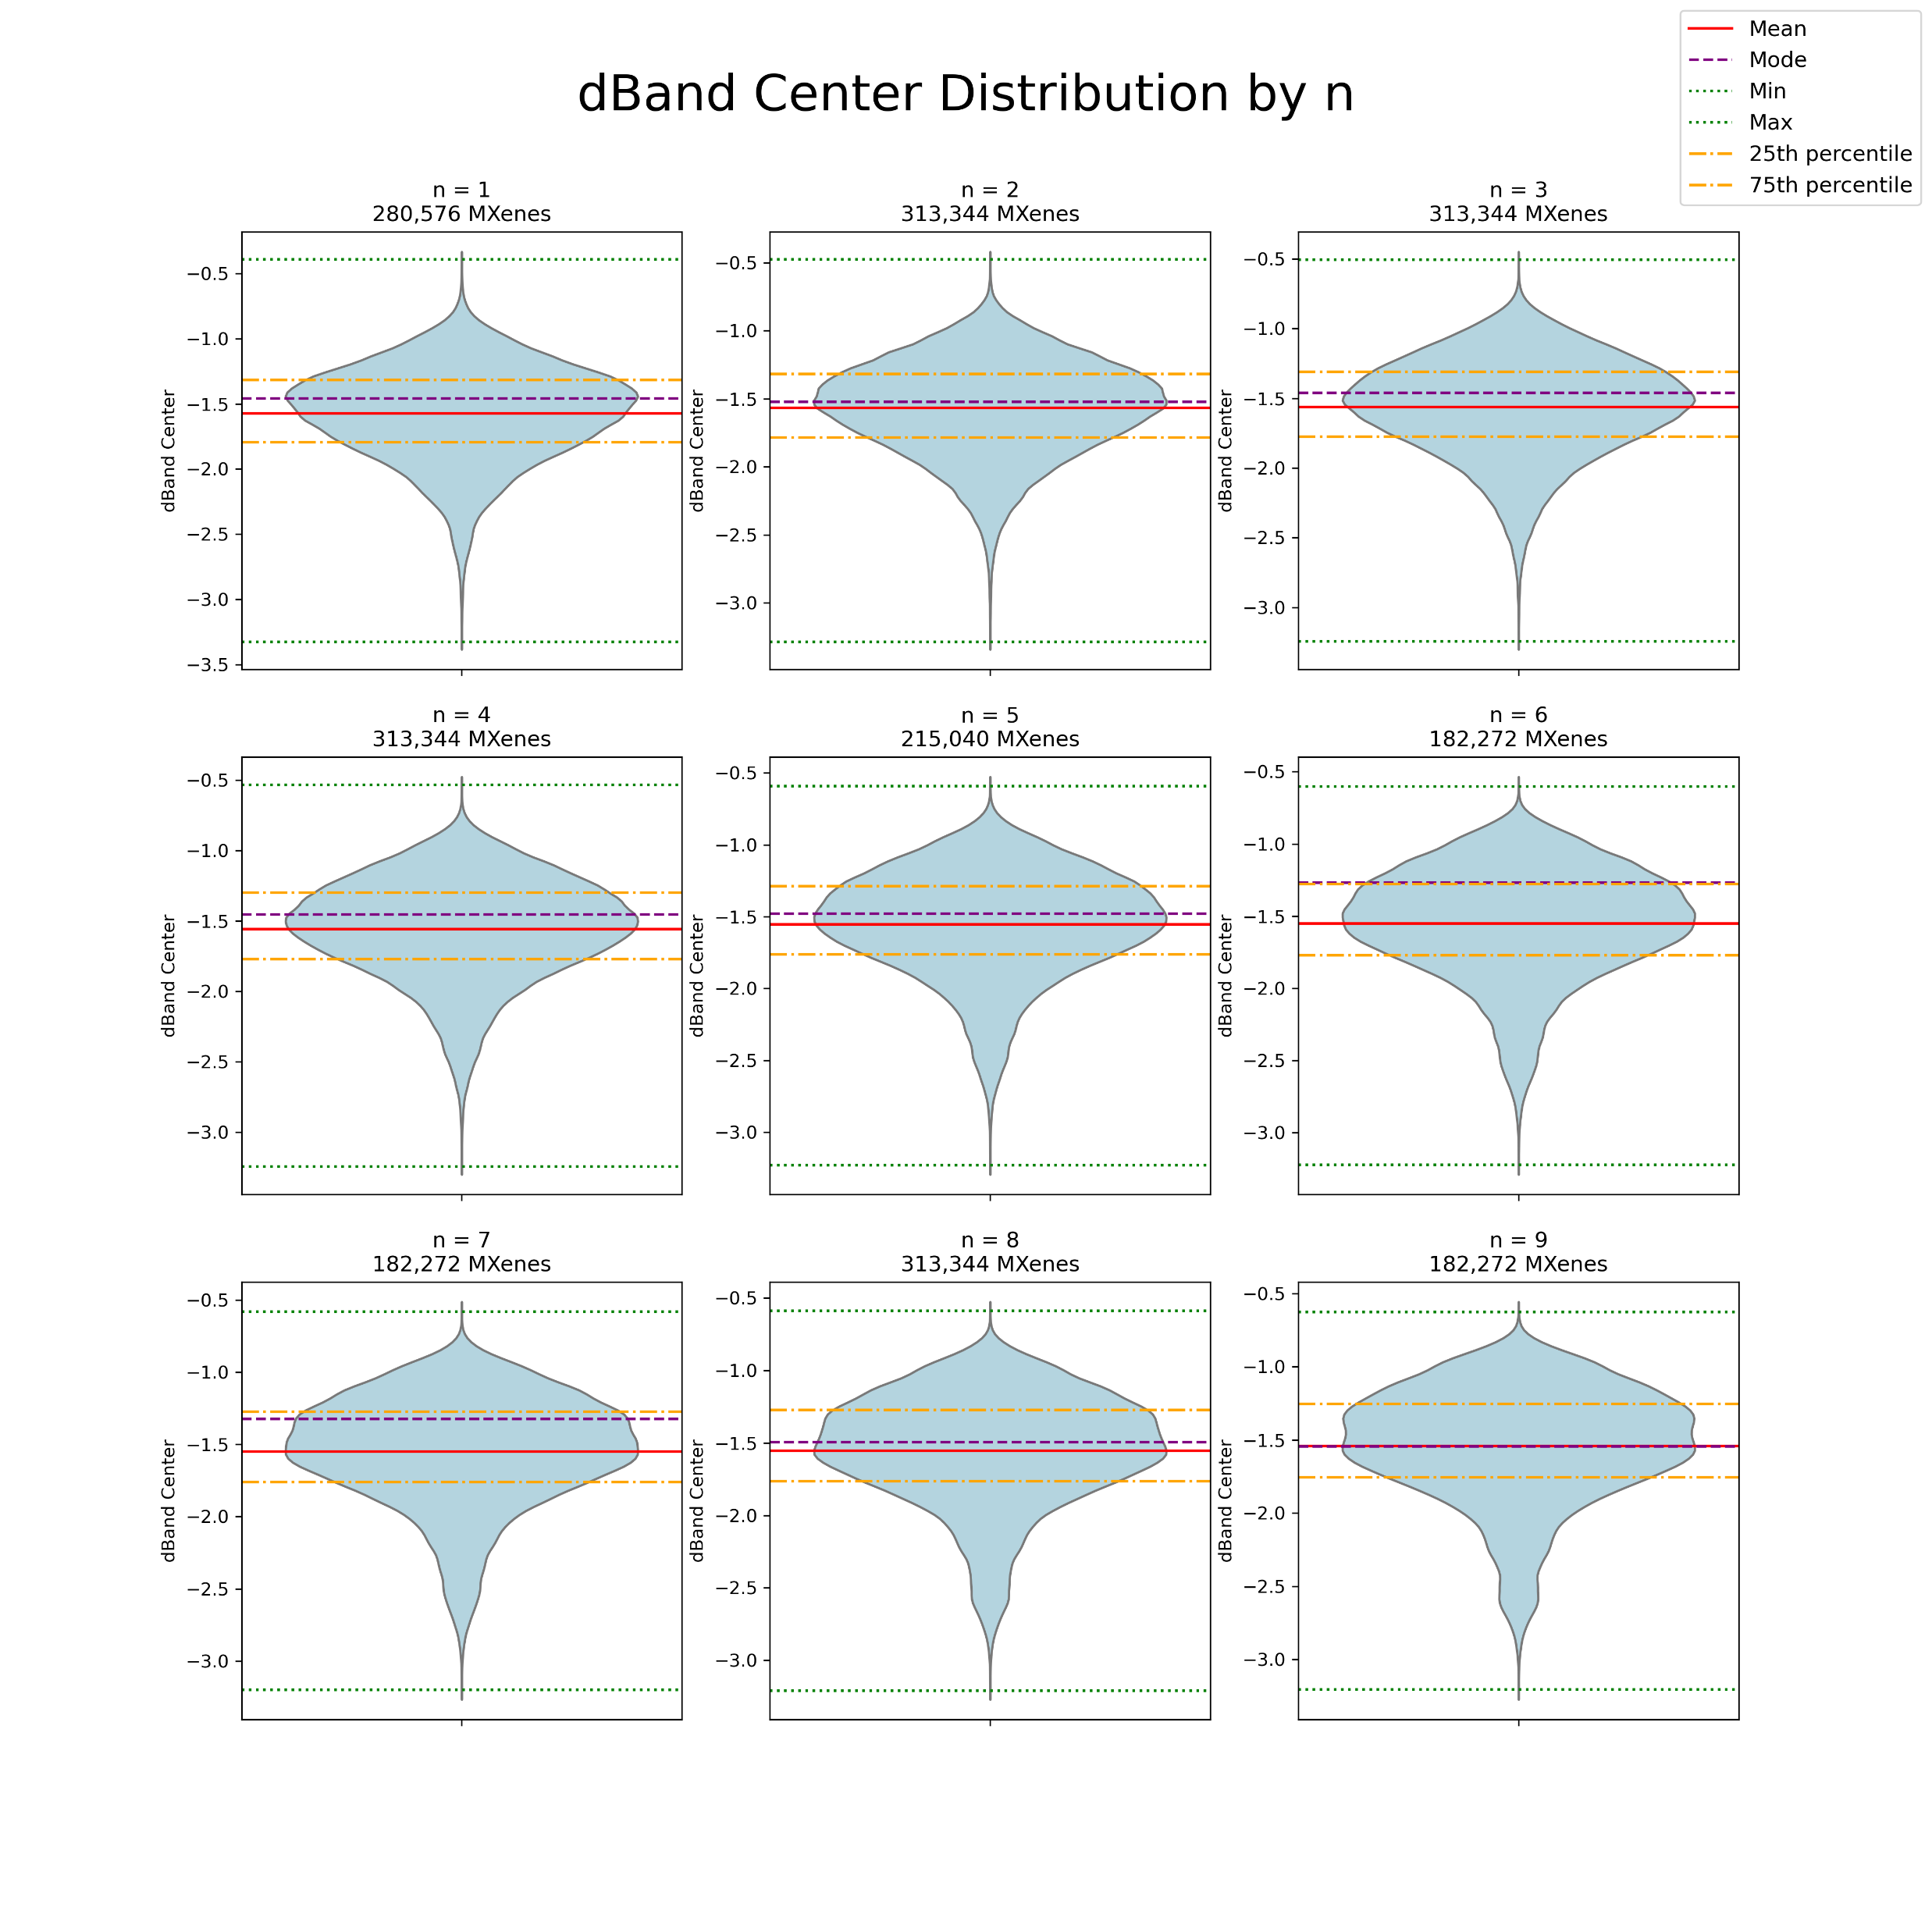

Slide 81
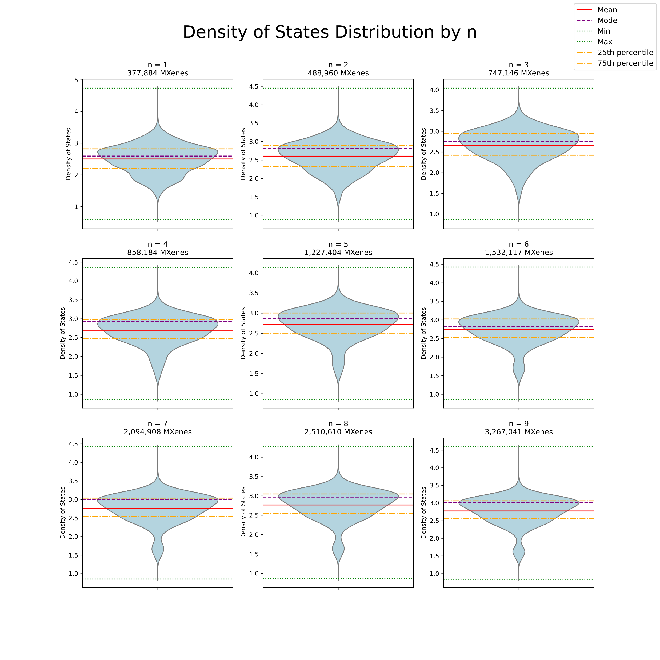
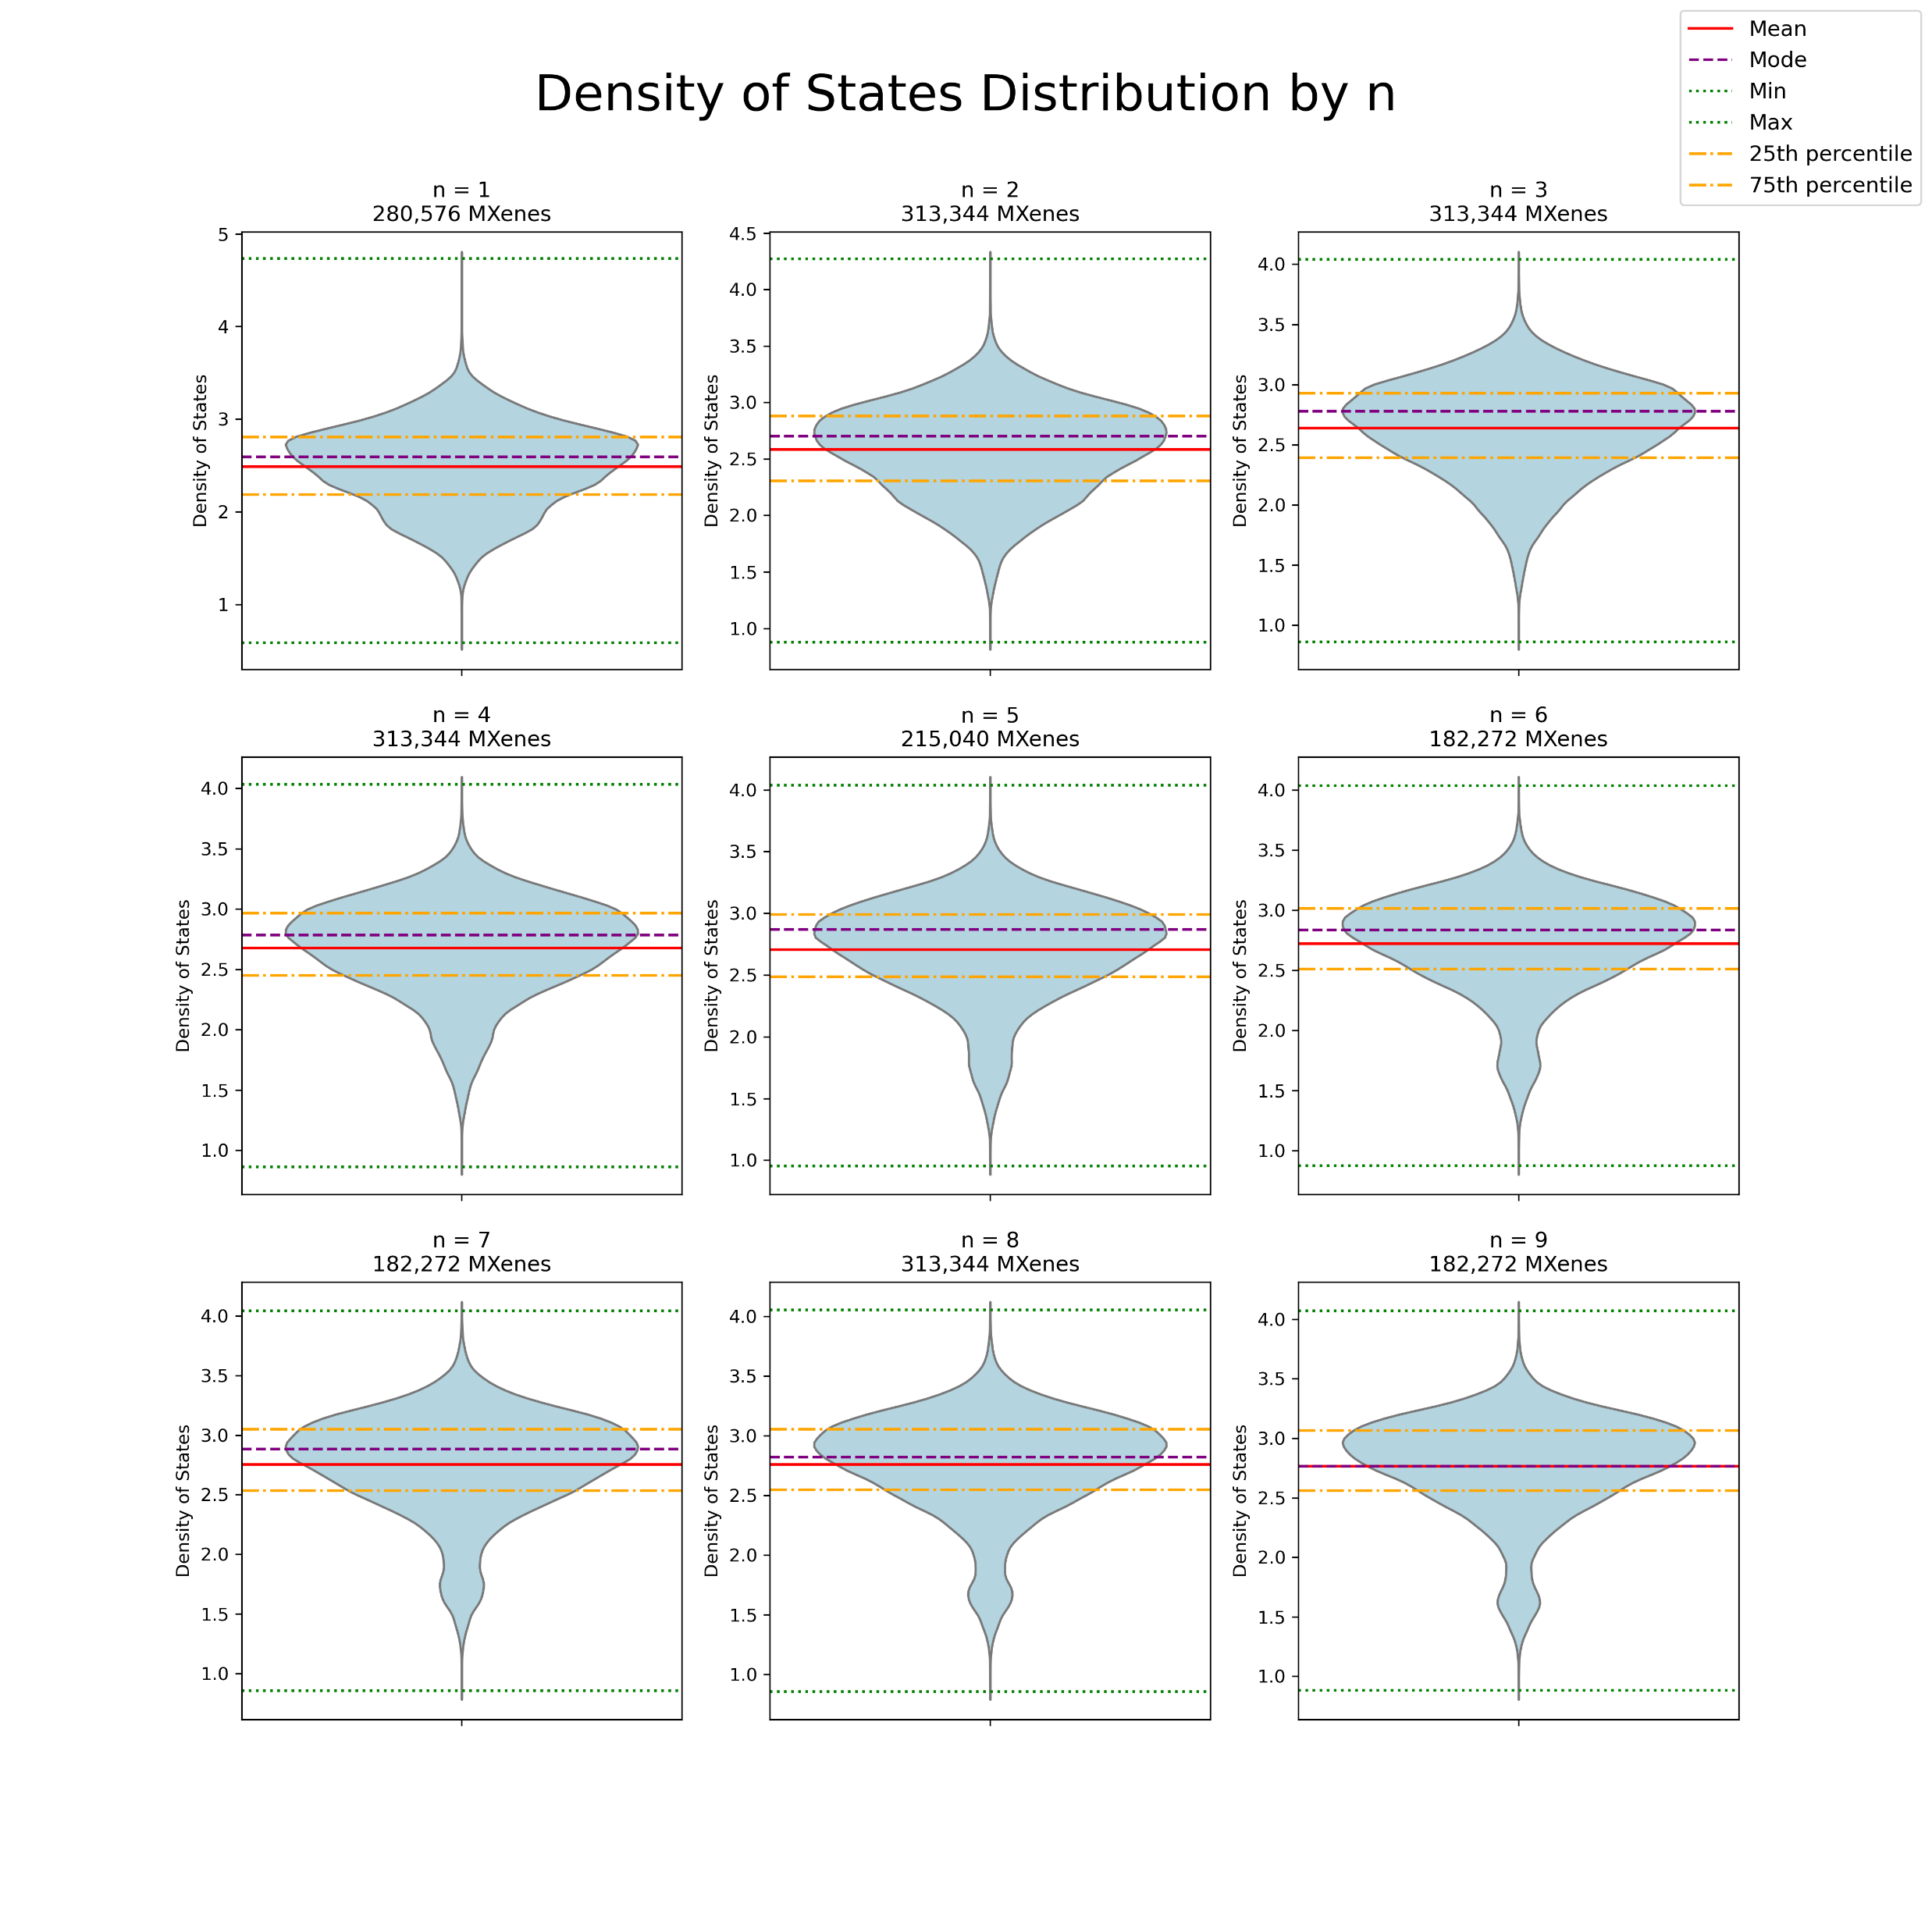

Slide 82
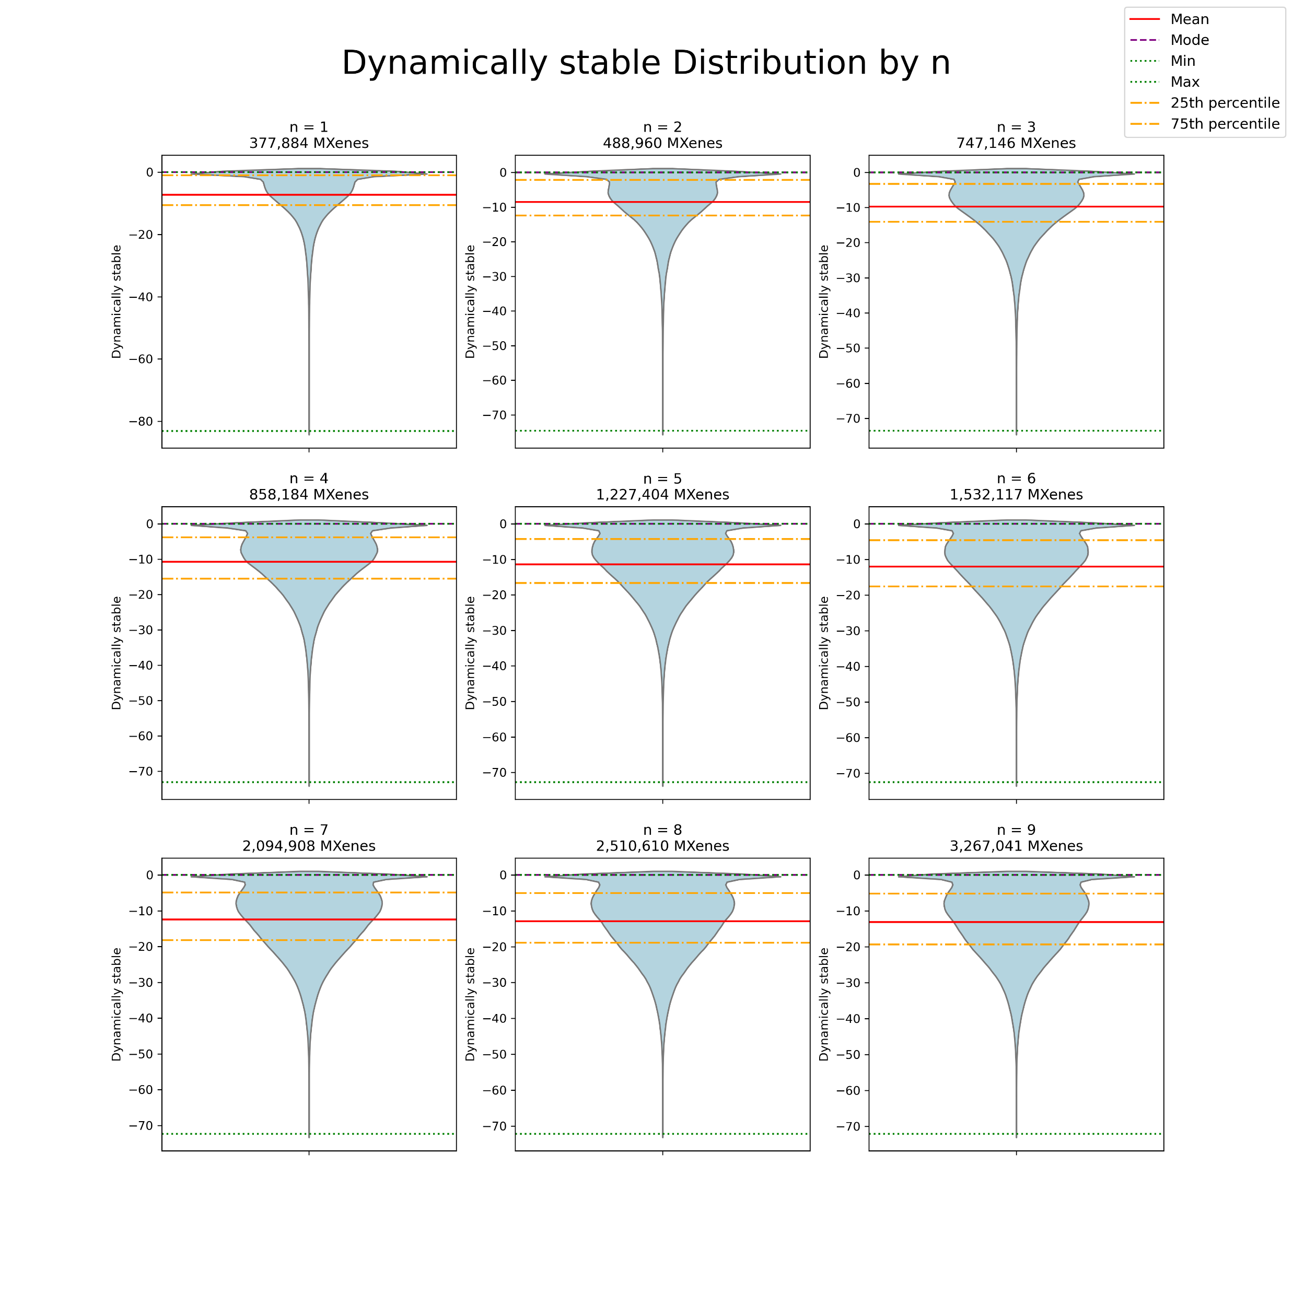
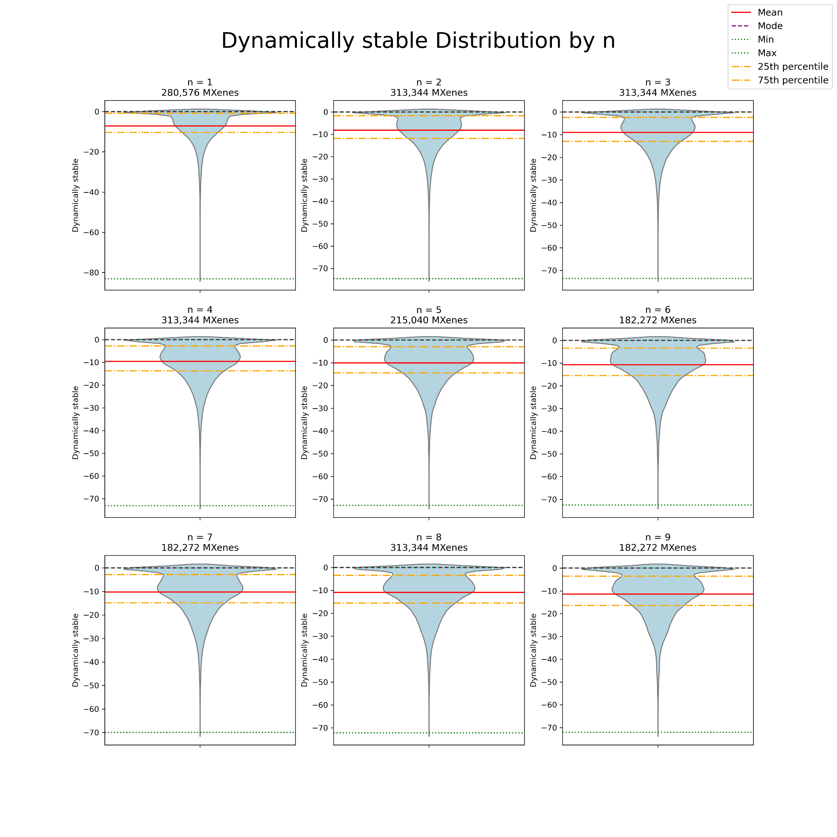

Slide 83
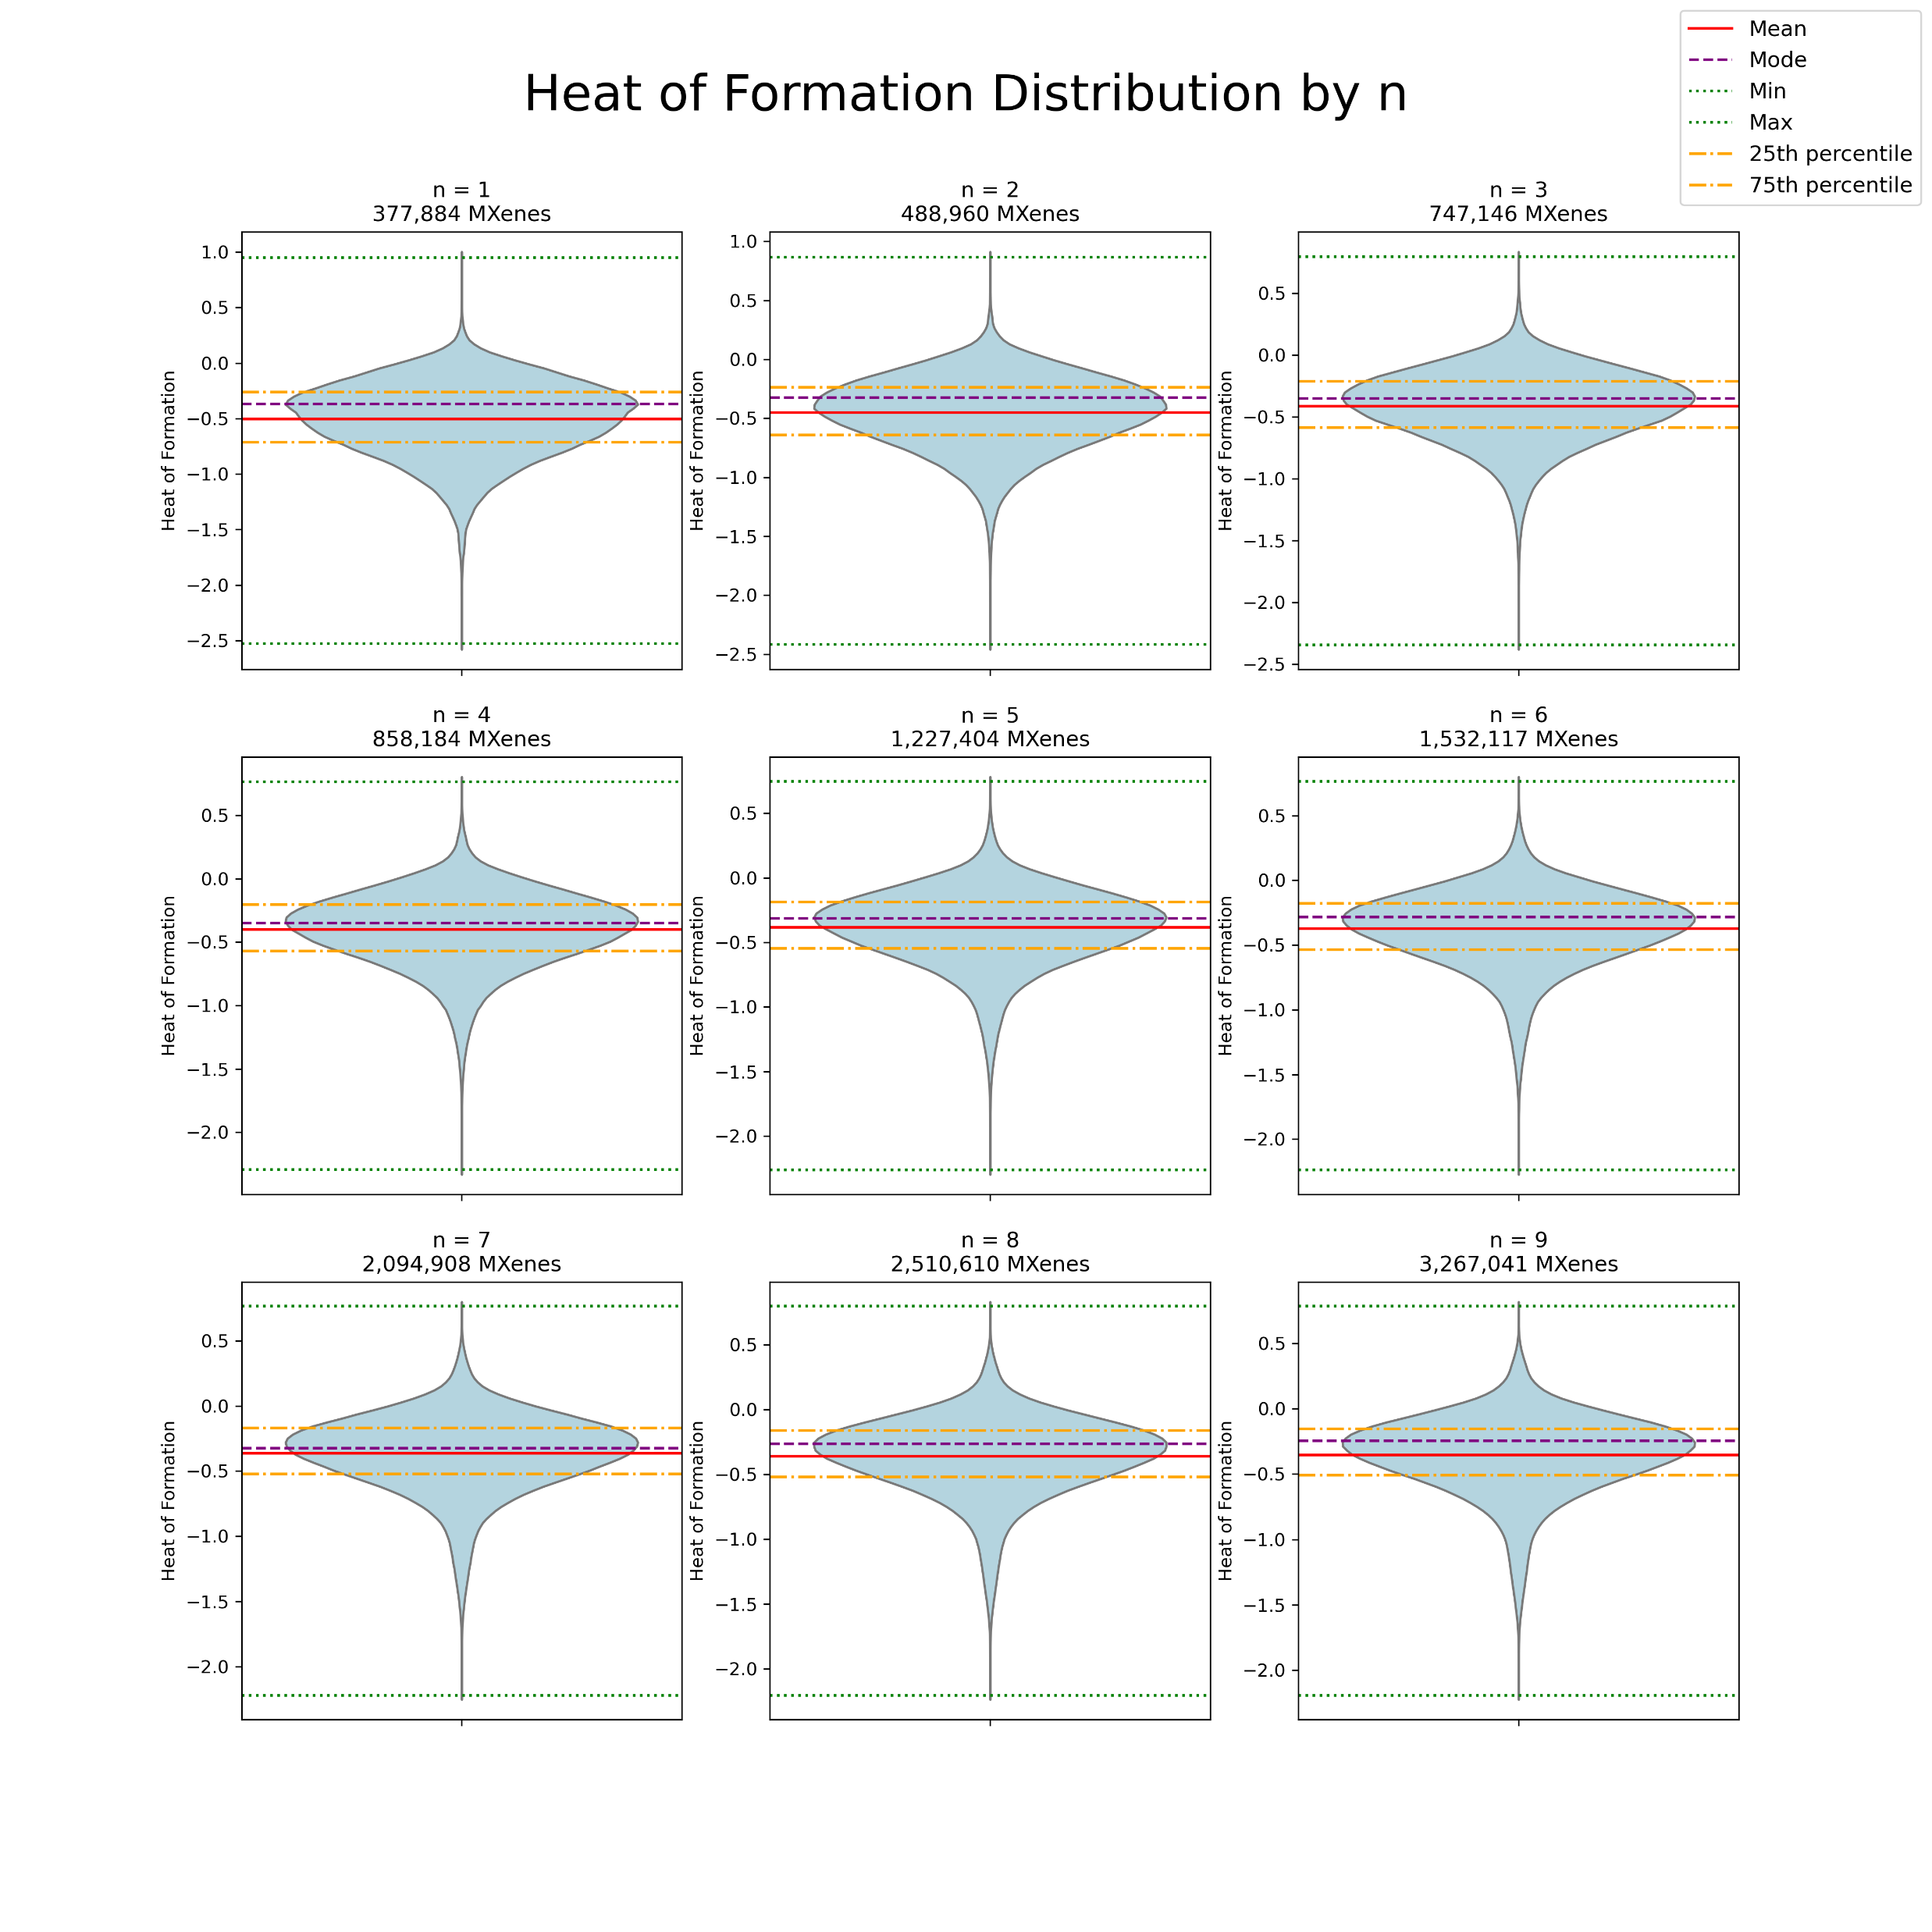
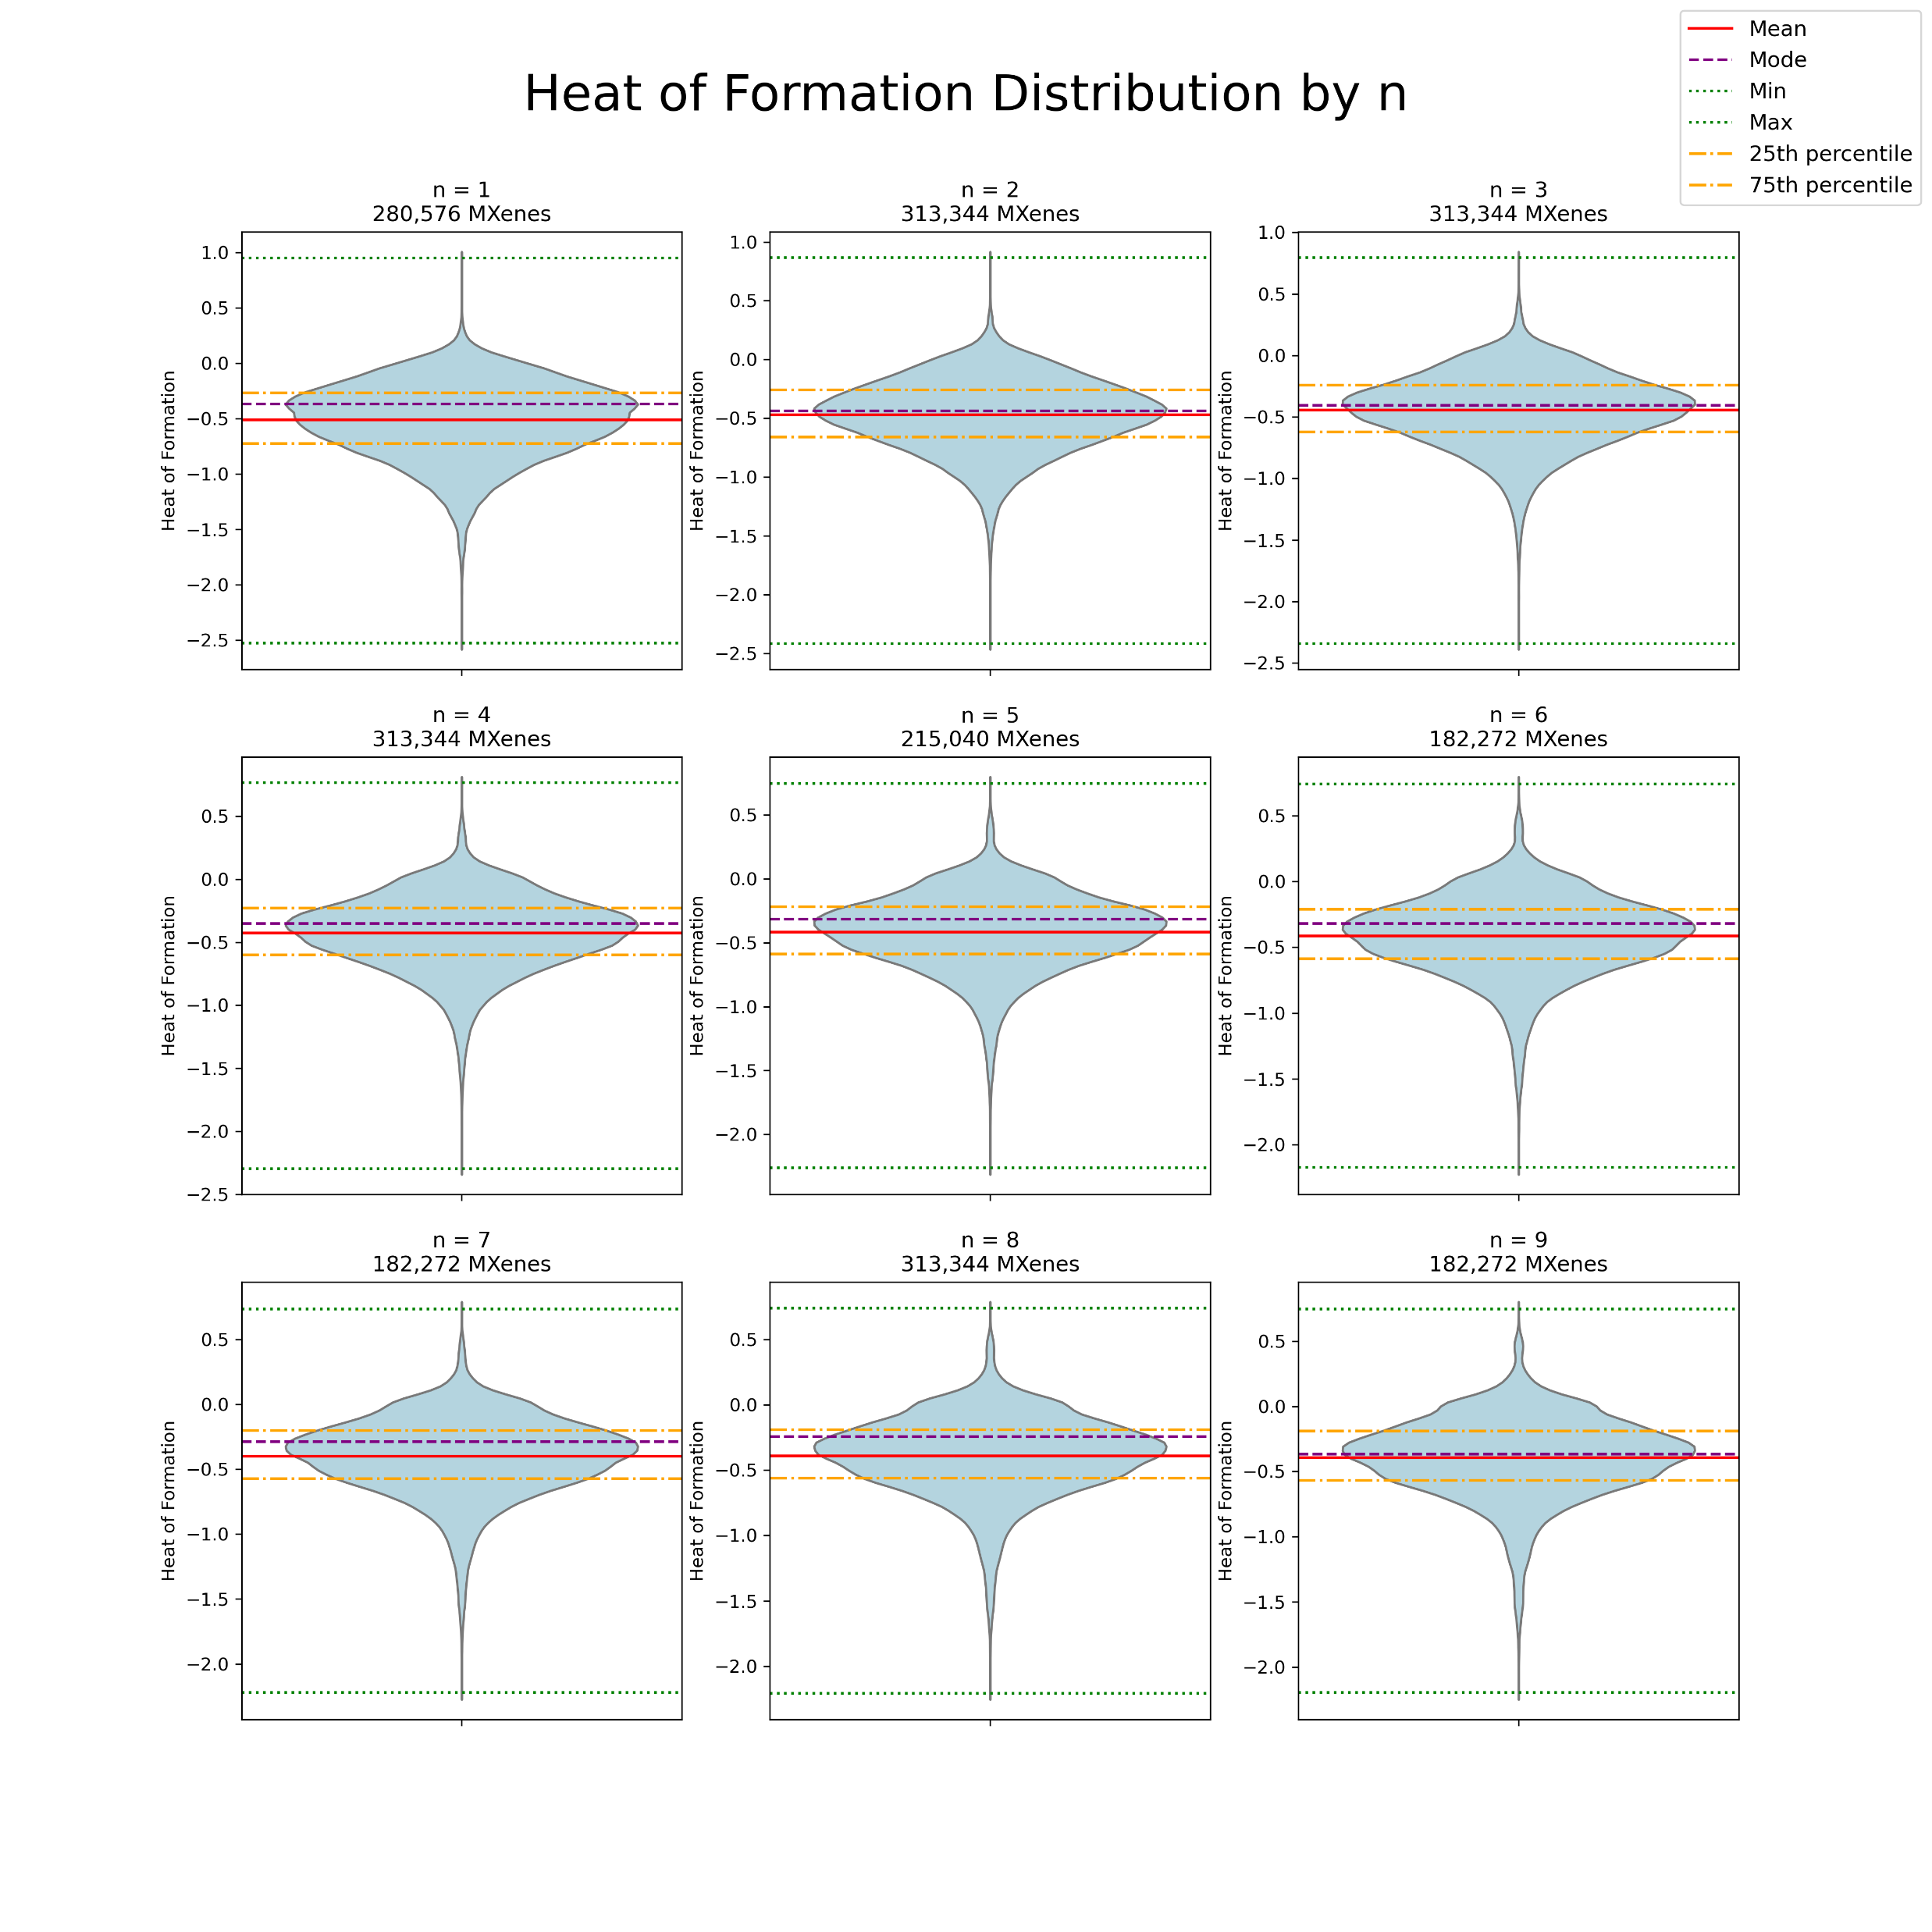

Slide 84
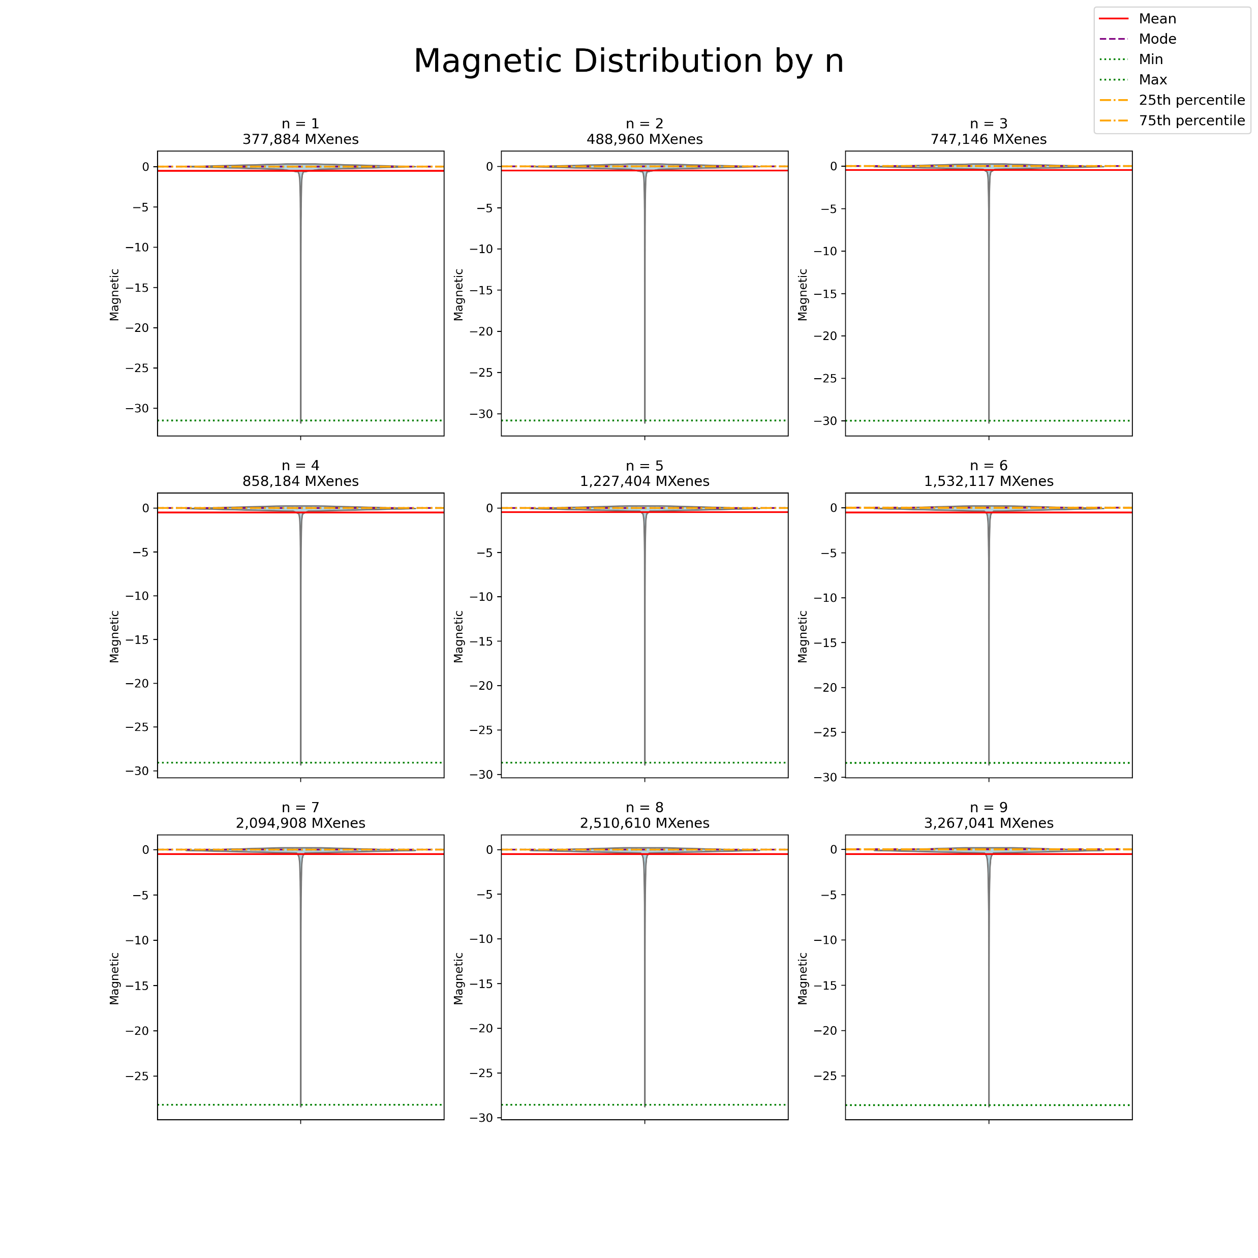
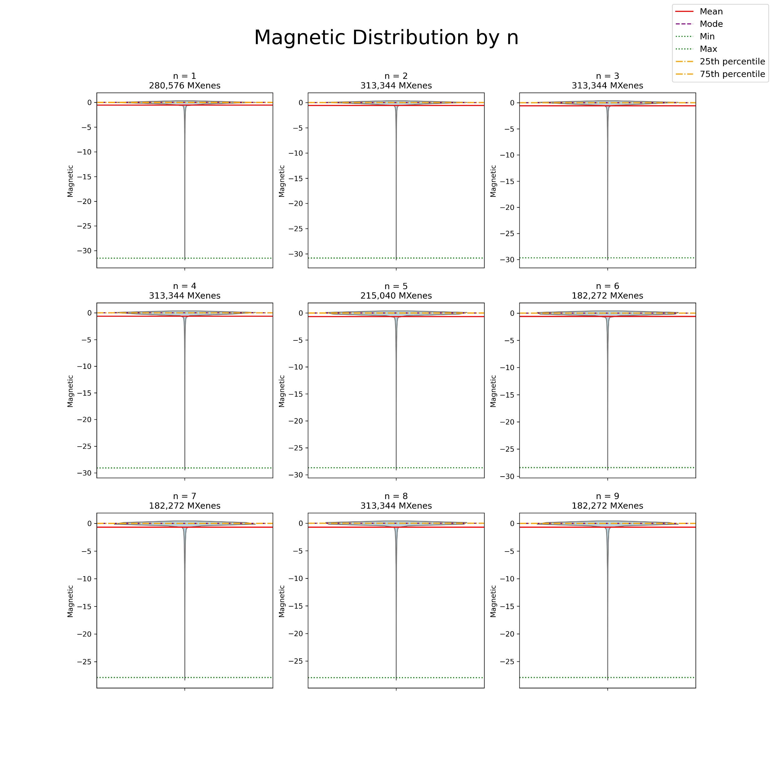

Slide 85
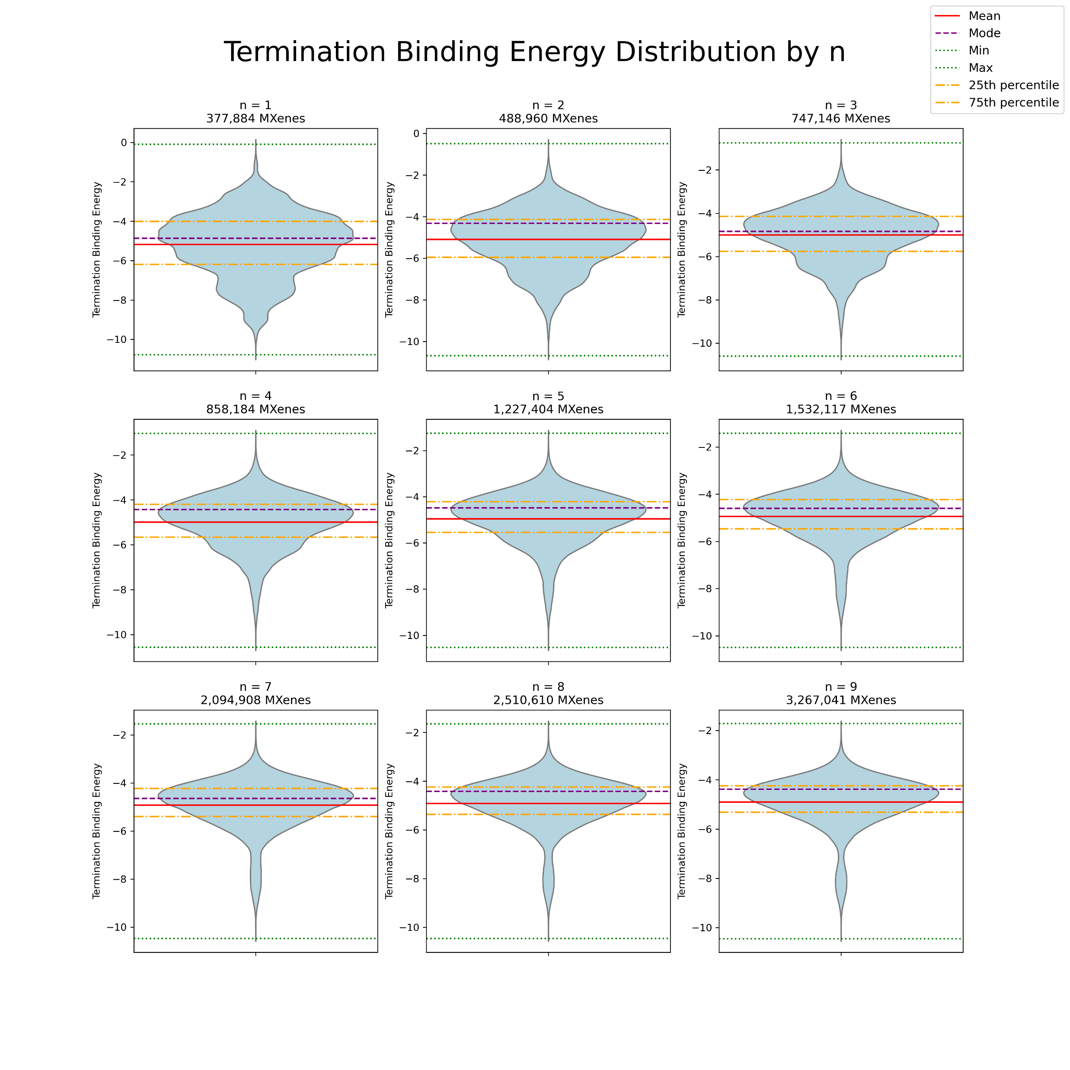
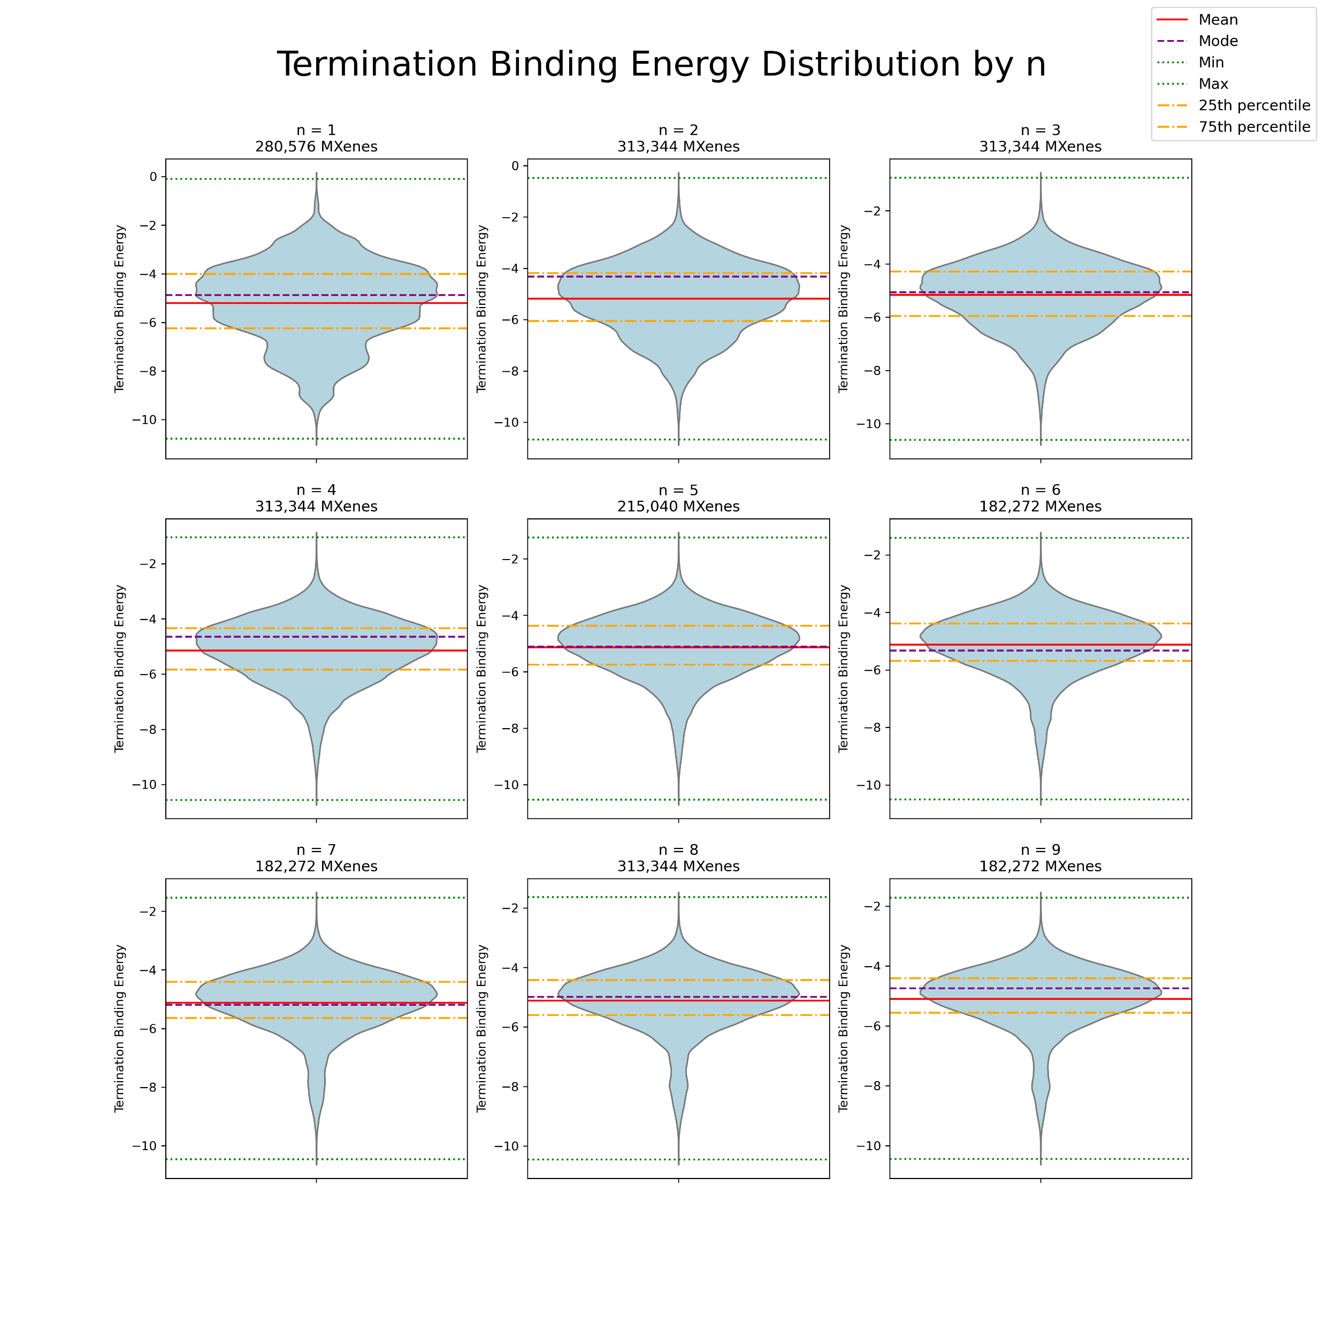

Slide 86
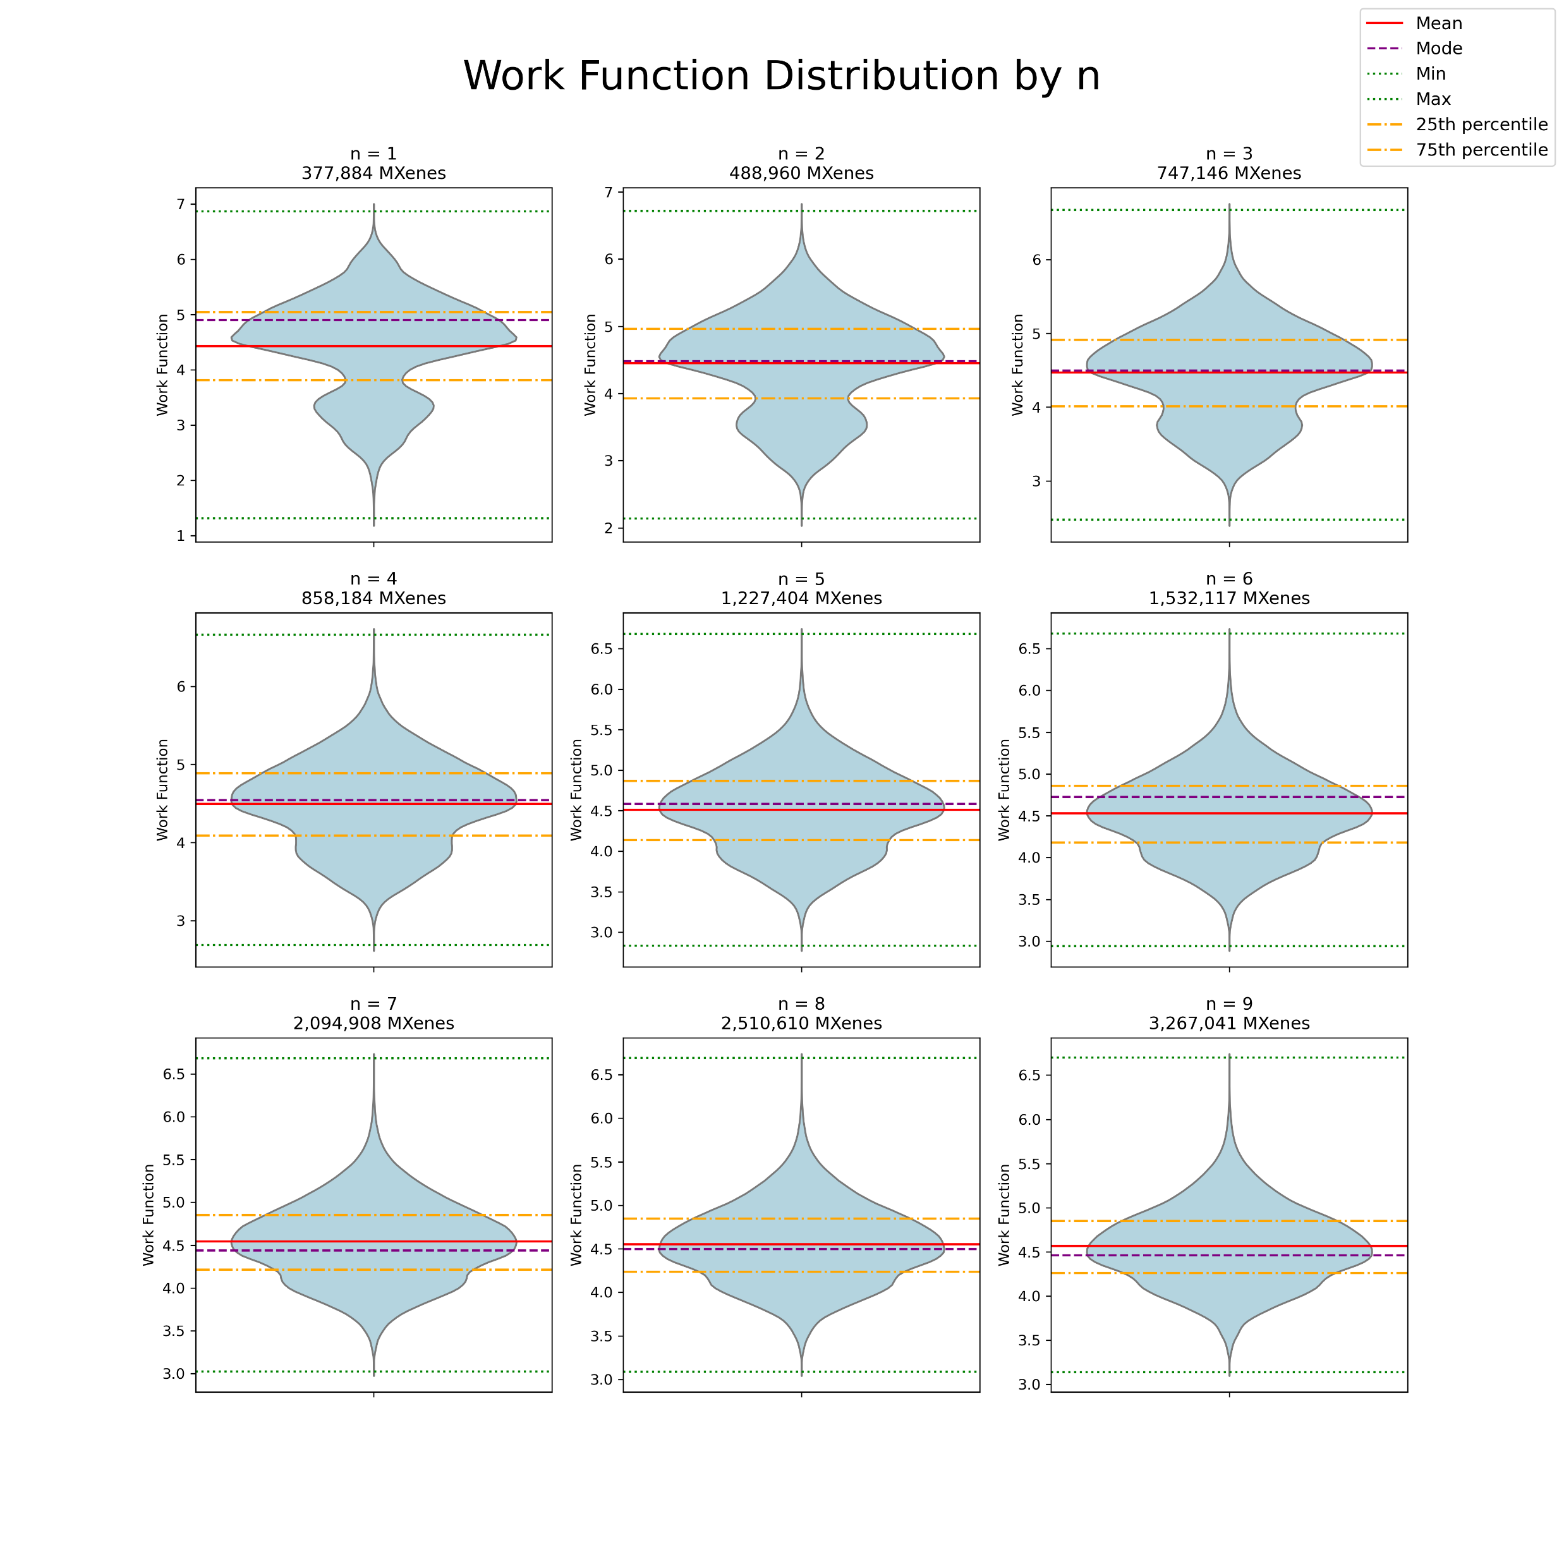
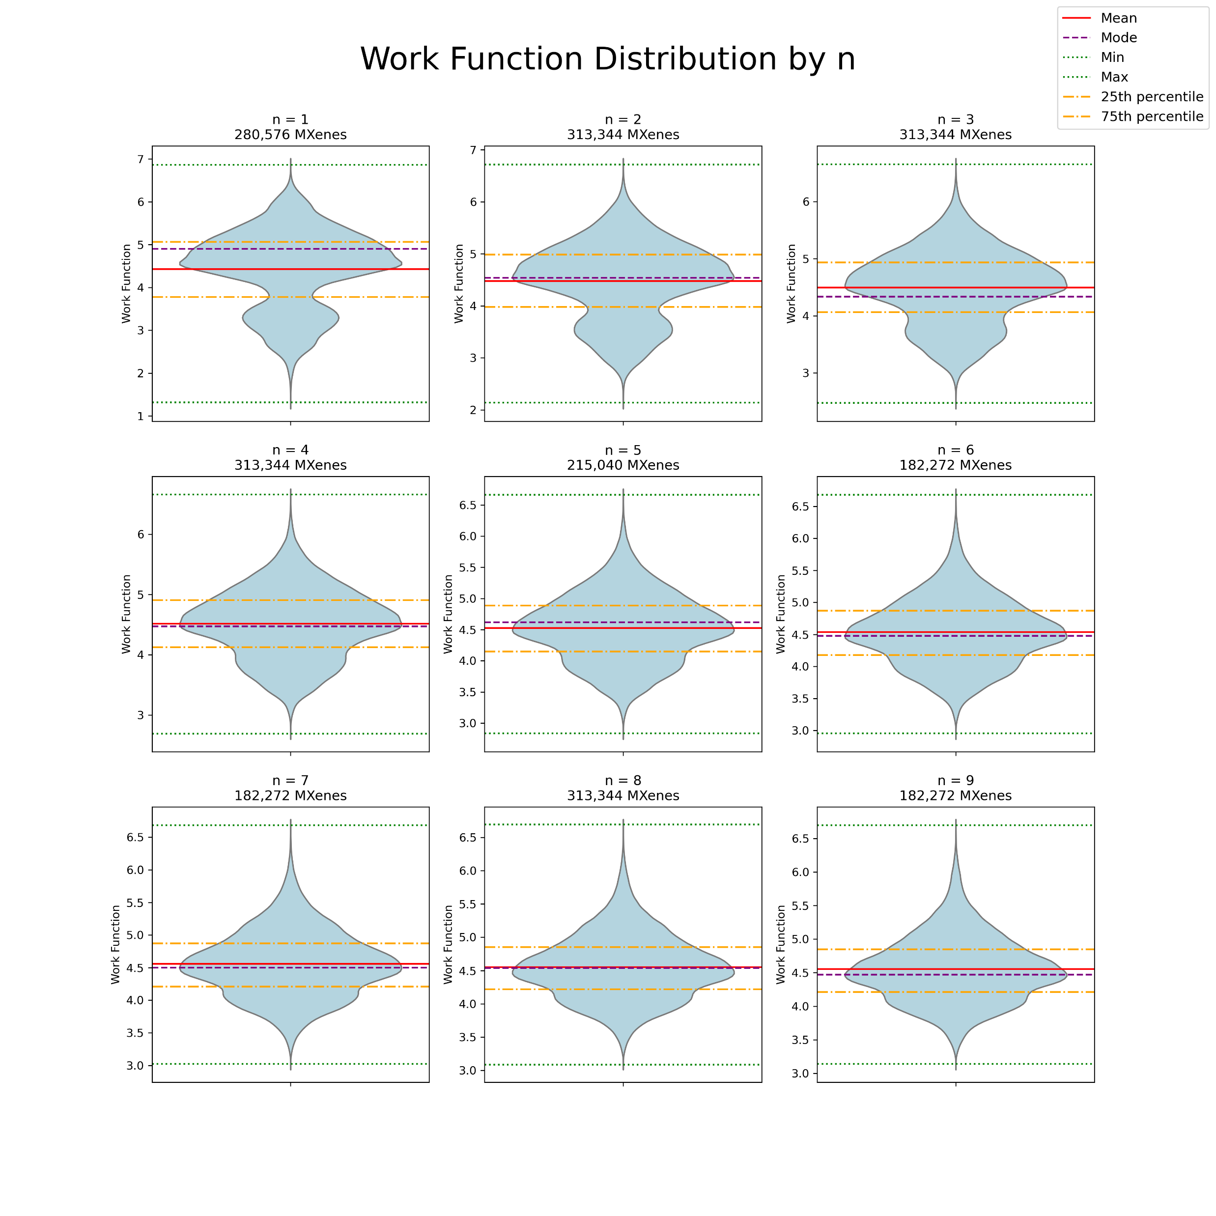

Slide 89
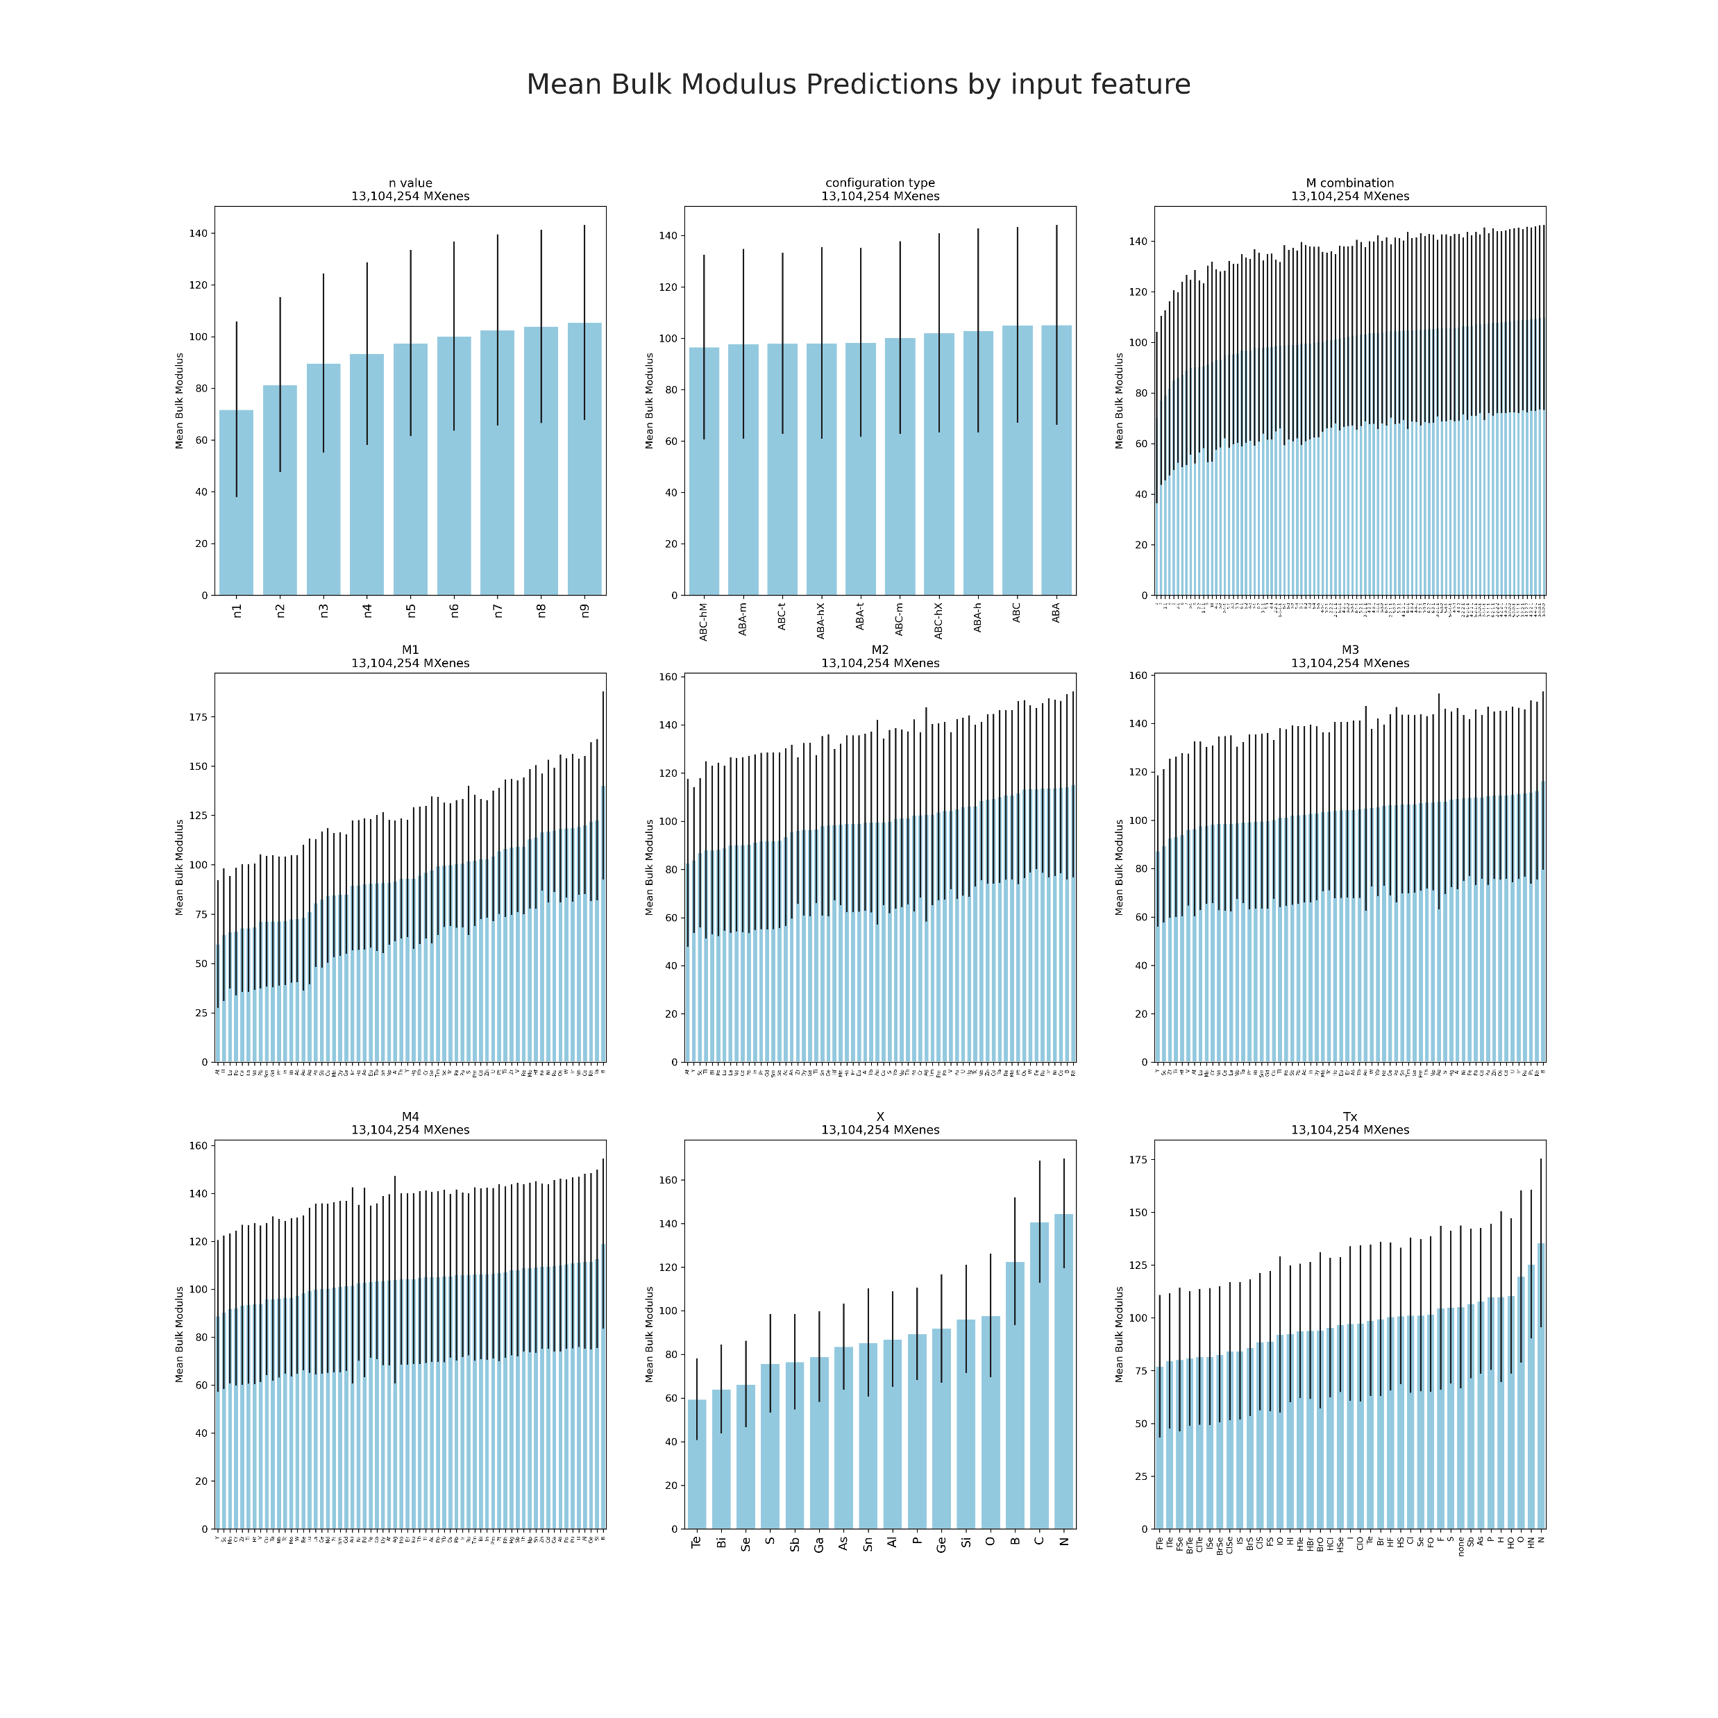
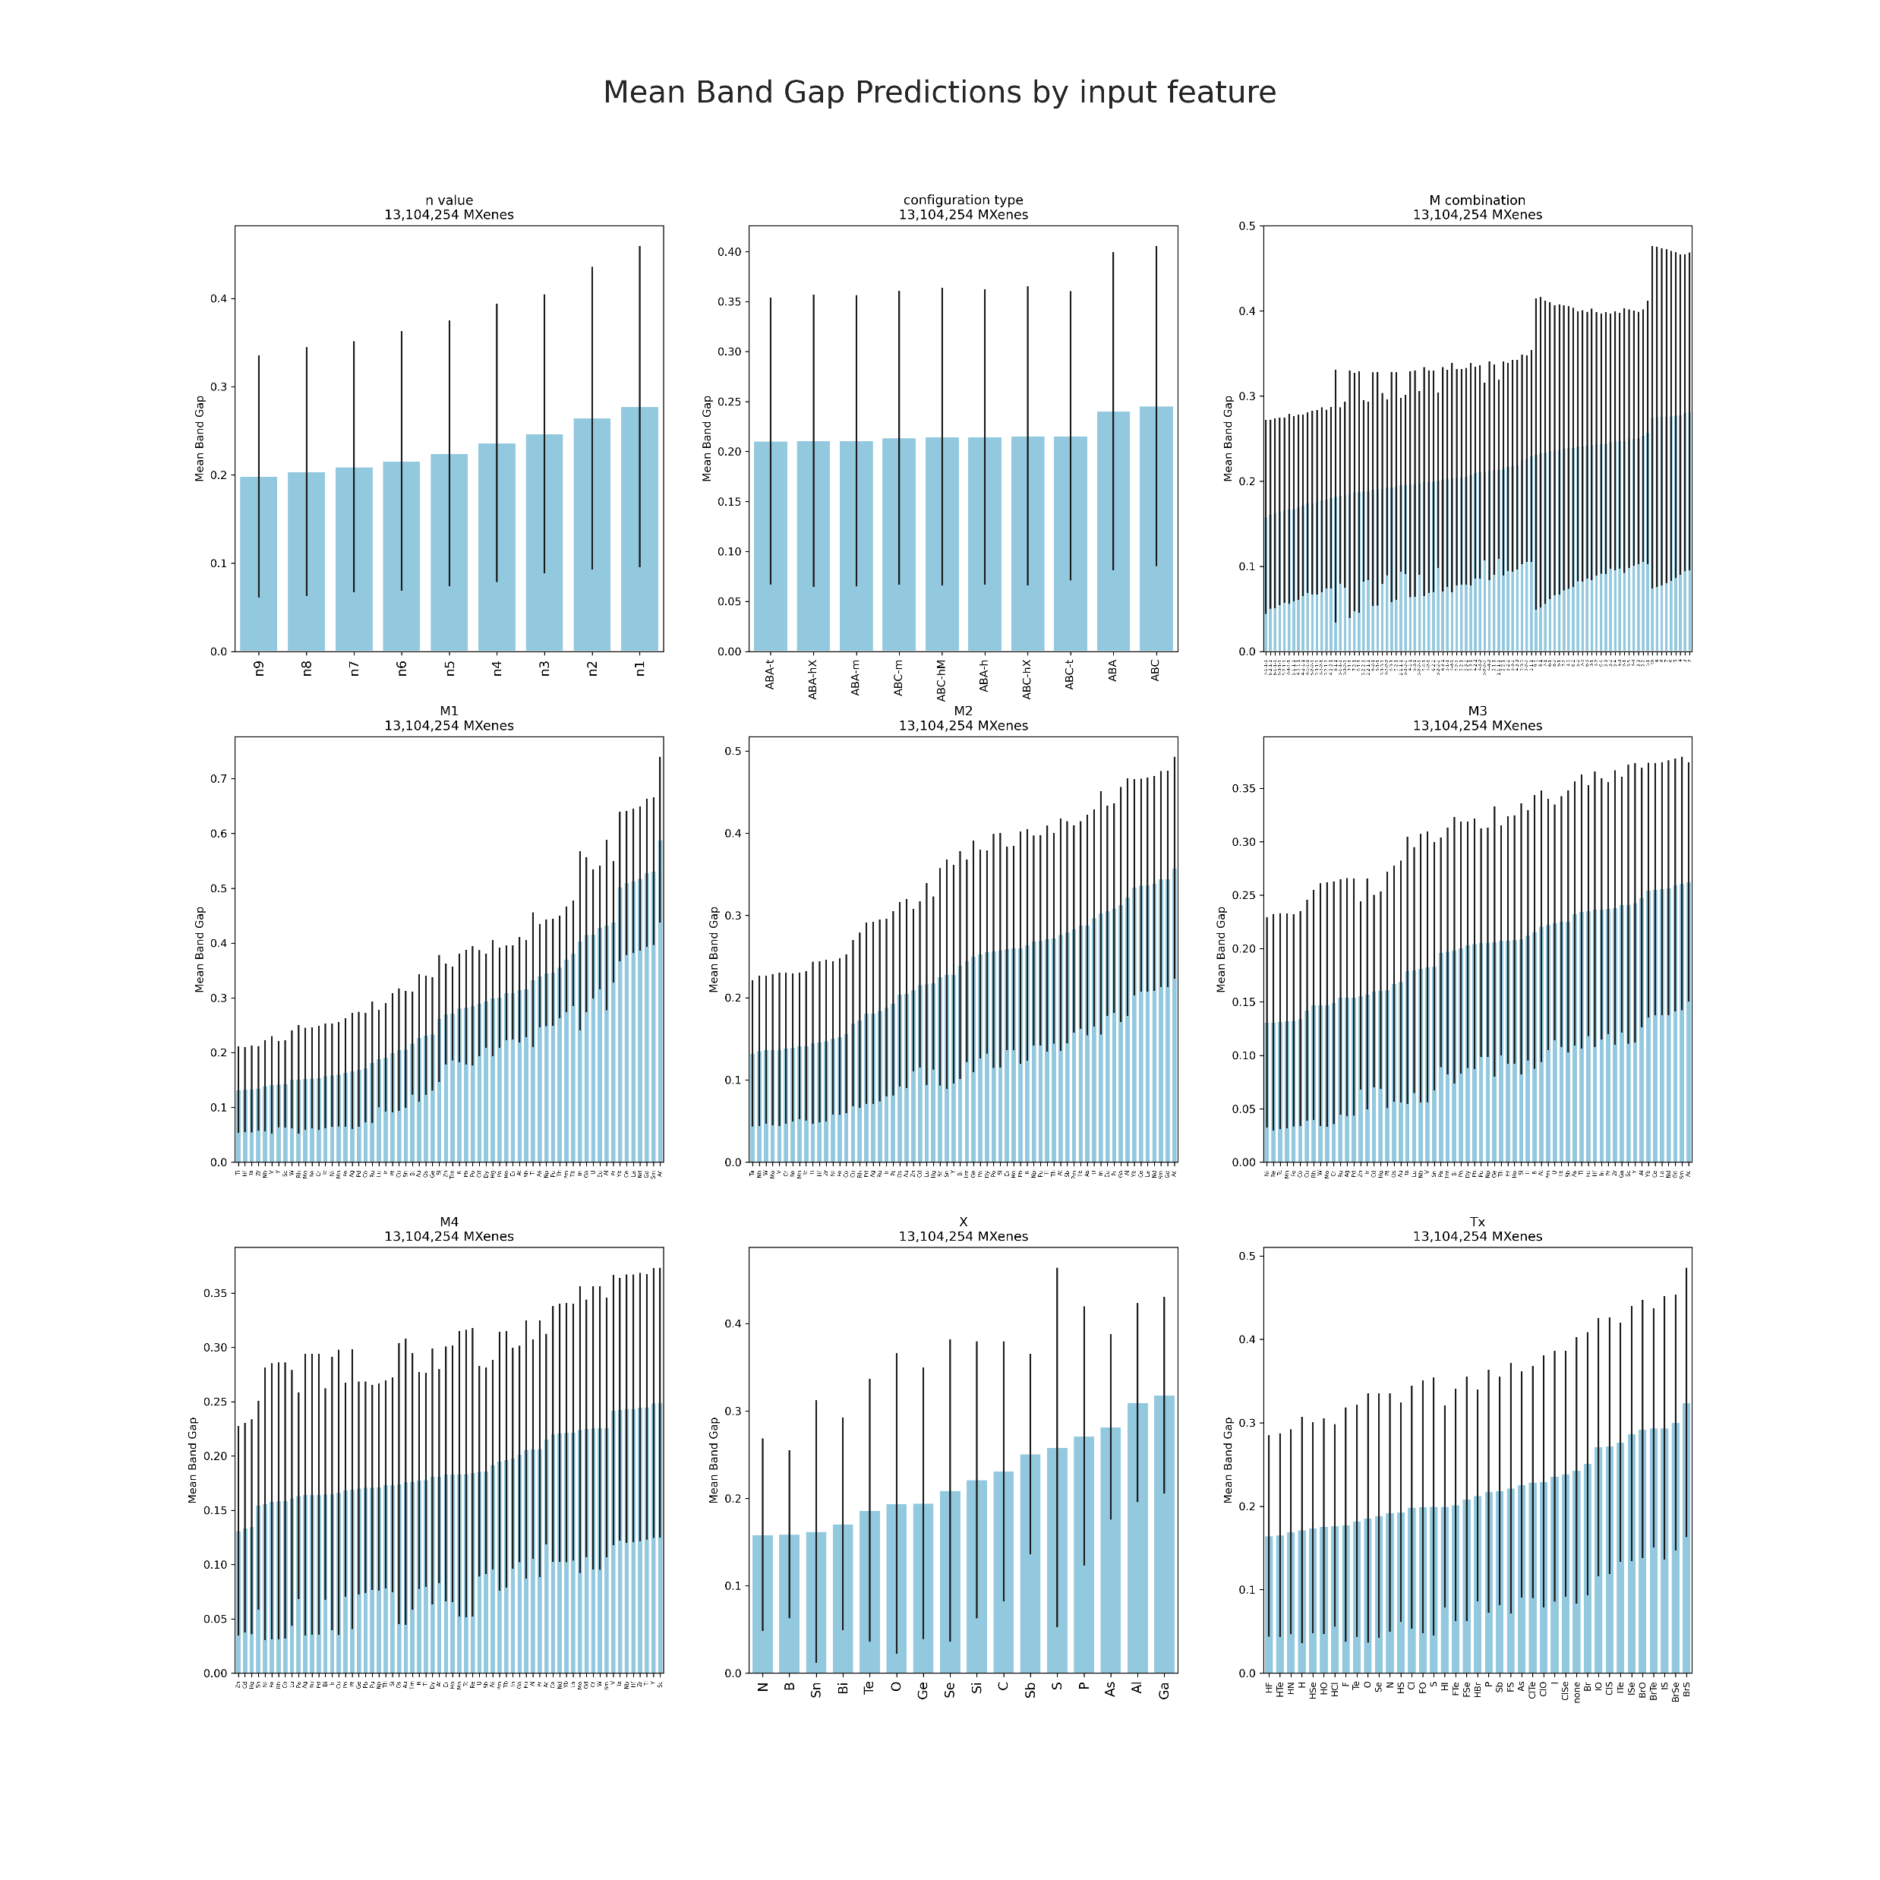

Slide 90
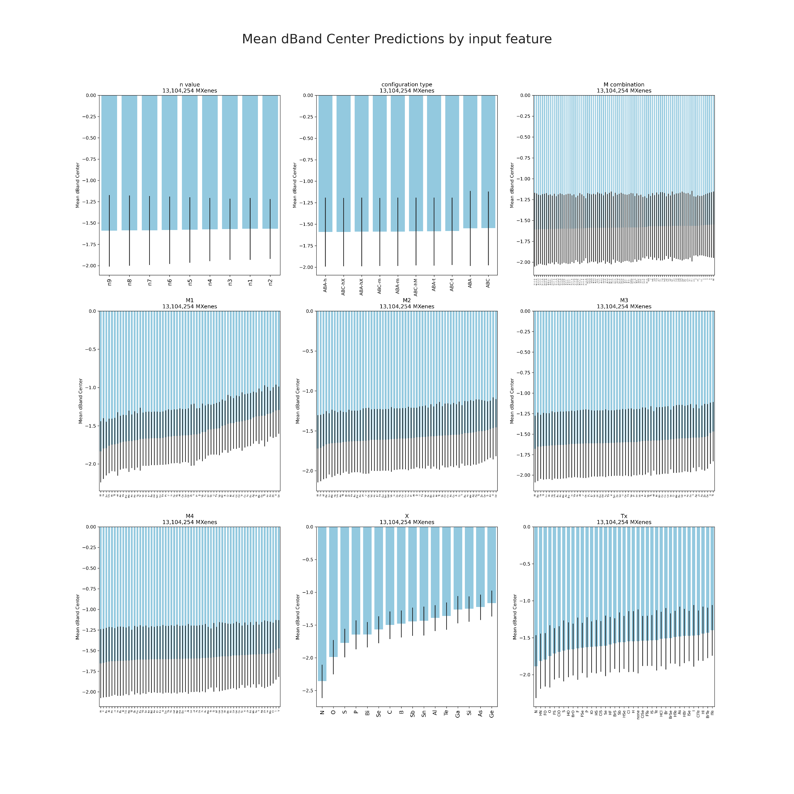

Slide 91
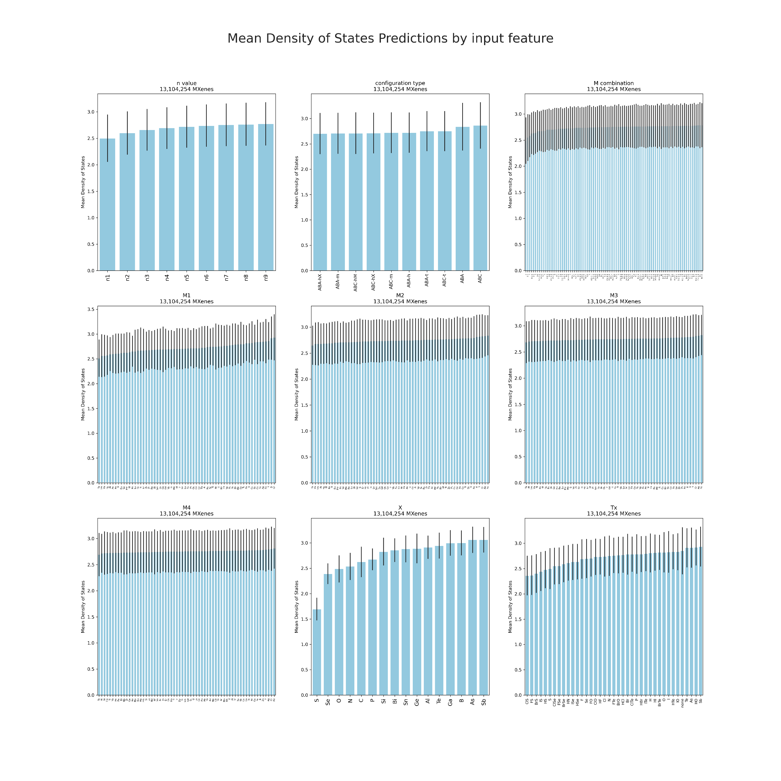

Slide 92
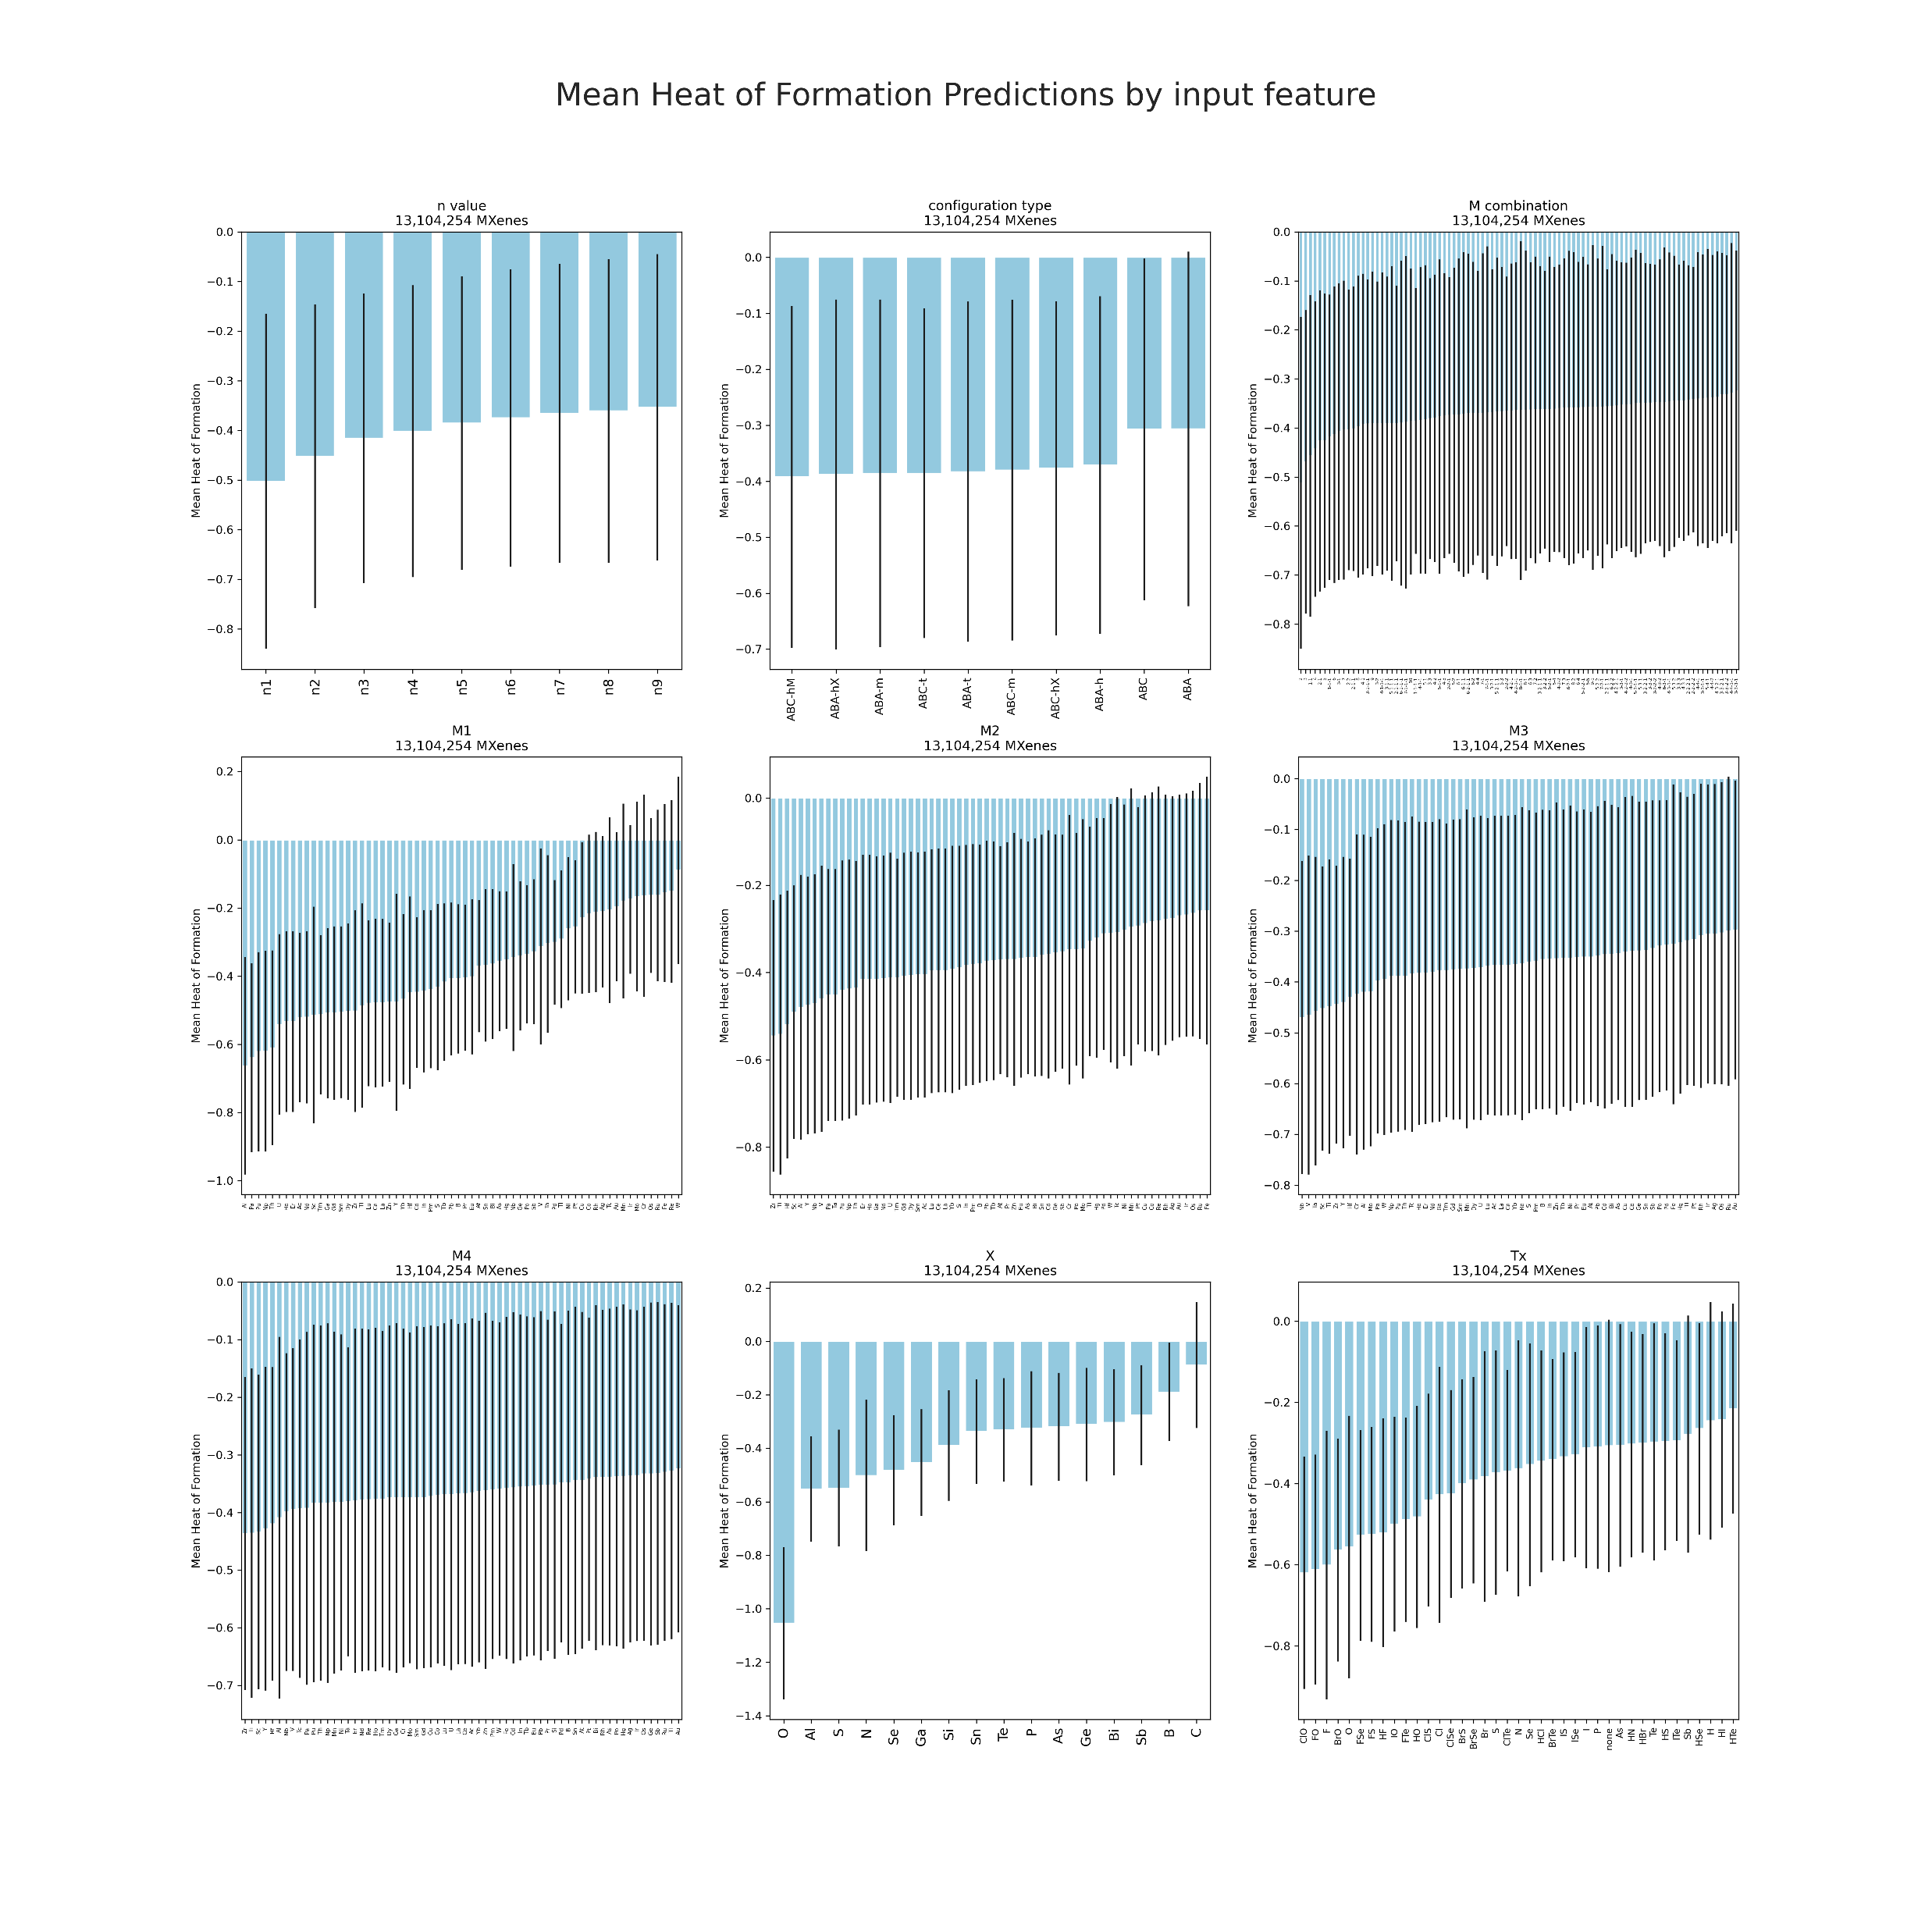

Slide 93


Slide 94


Slide 95


Slide 96


Slide 97


Slide 98


Slide 99


Slide 100


Slide 101


Slide 102


Slide 103

Work Function

Slide 104

Termination Binding Energy

Slide 105

Magnetic (T/F)

Slide 107
My Publication List
1. Eric Warnemunde Vertina, Emily Sutherland, Sajal Chakroborty, N. Aaron Deskins, and Oren Mangoubi. Deep Learning for High-Throughput MXene Property Prediction. IEEE NAP 2025. (Manuscript submitted 6/15/25, abstract has been accepted for presentation).
2. Eric Warnemunde Vertina, Sajal Chakroborty, Emily Sutherland, N. Aaron Deskins, and Oren Mangoubi. MXene Material Property Prediction via Transfer Learning with Graph Neural Networks. IEEE ICAD 2025. (Accepted for publication).
3. Eric Warnemunde Vertina, Emily Sutherland, N. Aaron Deskins, and Oren Mangoubi. “MXene Property Prediction via Graph Contrastive Learning.” IEEE NAP 2024.
4. Eric Warnemunde Vertina, Emily Sutherland, N. Aaron Deskins, and Oren Mangoubi. “Predicting MXene Properties via Machine Learning.” In Proceedings of the 2022 International Conference on Machine Learning and Applications (ICMLA).

Slide 108


Acknowledgment
I would like to thank:
Professor Oren Mangoubi, my advisor
My dissertation committee
Dr. Emily Sutherland, former WPI Physics PhD student
Dr. Sajal Chakroborty, WPI Post-Doctoral Scholar
Dr. Alex Moore, former WPI DS PhD student
Professor Elke Rundensteiner, CEDAR project director
Professor Randy Paffenroth, WPI Data Science
Professor Lyubov Titova, WPI Physics
This research was supported in part by the NSF under grant NRT-HDR-2021871
Notes:
Say that Emily and Prof. Deskins were coauthors for the conference paper

Slide 110
References
[1] Mohammad Khazaei, Masao Arai, Taizo Sasaki, Chan-Yeup Chung, Natarajan S. Venkataramanan, Mehdi Estili, Yoshio Sakka, Yoshiyuki Kawazoe. “Novel Electronic and Magnetic Properties of Two-Dimensional Transition Metal Carbides and Nitrides.” Adv. Funct. Mater. 2013, 23, 2185–2192.
[2] Yury Gogotsi and Qing Huang. "MXenes: Two-Dimensional Building Blocks for Future Materials and Devices." ACS Nano 2021, 15, 5775-5780.
[3] Sutherland and N. A. Deskins. unpublished.
[4] Kamal Choudhary and Brian DeCost. Atomistic line graph neural network for improved materials property predictions. Npj Computational Materials, 7(1), November 2021.
[5] Vishu Gupta, Kamal Choudhary, Brian DeCost, Francesca Tavazza, Carelyn Campbell, Wei-keng Liao, Alok Choudhary, and Ankit Agrawal. Structure-aware graph neural network based deep transfer learning framework for enhanced predictive analytics on diverse materials datasets. npj Computational Materials, 10(1):1, 2024.
[6] B. Anasori and Y. Gogotsi. 2D Metal Carbides and Nitrides (MXenes) Structure, Properties and Applications. Springer, 06 2019.
[7] E. Vertina, N. A. Deskins, E. Sutherland, and O. Mangoubi. Predicting MXene properties via machine learning. pages 1573–1578. ICMLA, 2022.
[8] Yu Xie and P. R. C. Kent. “Hybrid density functional study of structural and electronic properties of functionalized Tin+1 X n (X = C, N) monolayers.” PHYSICAL REVIEW B 87, 235441 (2013).
[9] P. Reiser et al. Graph neural networks for materials science and chemistry, 2022.
[10] Y. Zhu, Y. Xu, Q. Liu, and S. Wu. An empirical study of graph contrastive learning, 2021.

Slide 111
References (continued)
[11] H. Bing, O. A. von Lillenfeld, and D. Bakowies. personal communication. 2017.
[13] A. Rajan et al. Machine-learning-assisted accurate band gap predictions of functionalized MXene. Chemistry of Materials, 30(12):4031–4038, 2018.
[17] Yanqiao Zhu, Yichen Xu, Feng Yu, Qiang Liu, Shu Wu, and Liang Wang. Graph contrastive learning with adaptive augmentation. In WWW, pages 2069–2080, 2021.
[18] Nian Liu, Xiao Wang, Deyu Bo, Chuan Shi, and Jian Pei. Revisiting Graph Contrastive Learning from the Perspective of Graph Spectrum. NeurIPS 2022.
[19] Adrien Bardes, Jean Ponce, and Yann LeCun. VICReg: Variance-invariance-covariance regularization for self-supervised learning. arXiv preprint arXiv:2105.04906 (2021).
[20] Sherry Yang, KwangHwan Cho, Amil Merchant, Pieter Abbeel, Dale Schuurmans, Igor Mordatch, and Ekin Dogus Cubuk. Scalable diffusion for materials generation, 2024.
[21] Michael Alverson, Sterling G. Baird, Ryan Murdock, (Enoch) Sin-Hang Ho, Jeremy Johnson, and Taylor D. Sparks. Generative adversarial networks and diffusion models in material discovery. Digital Discovery, 3:62–80, 2024.
[22] Yuval Elbaz, David Furman, and Maytal Caspary Toroker. Modeling diffusion in functional materials: From density functional theory to artificial intelligence. Advanced Functional Materials, 30(18):1900778, 2020.
[30] Hironao Yamada, Chang Liu, Stephen Wu, Yukinori Koyama, Shenghong Ju, Junichiro Shiomi, Junko Morikawa, and Ryo Yoshida. Predicting materials properties with little data using shotgun transfer learning. ACS Central Science, 5(10):1717–1730, 2019. PMID: 31660440.
[31] I. Goodfellow, Y. Bengio, and A. Courville. Deep Learning. MIT Press, 2016. http: //www.deeplearningbook.org.
[35] S. Haastrup et al. The Computational 2D Materials Database: high-throughput modeling and discovery of atomically thin crystals. 2D Materials, 5(4), 09 2018.
[36] M. N. Gjerding et al. Recent progress of the Computational 2D Materials Database(C2DB). 2D Materials, 8(4), 09 2018.
[38] A. Jain et al. Commentary: The Materials Project: A materials genome approach to accelerating materials innovation. APL Materials, 1(1):011002, 07 2013.
[39] Xing-Hao Cui, Xiao-Hong Li, Xiu-Juan Jin, Rui-Zhou Zhang, Hong-Ling Cui, and Hai-Tao Yan. First-principles study on the effect of atomic swap on the electronic properties and quantum capacitance of sc2cf2 monolayer. Vacuum, 204:111371, 2022.

Slide 112
References (continued)
[40] Xing-Hao Cui, Xiao-Hong Li, Rui-Zhou Zhang, Hong-Ling Cui, and Hai-Tao Yan. Theoretical insight into the electronic, optical, and photocatalytic properties and quantum capacitance of sc2ct2 (t = f, p, cl, se, br, o, si, s, oh) mxenes. Vacuum, 207:111615, 2023.
[41] M. Faraji, A. Bafekry, M. M. Fadlallah, F. Molaei, N. N. Hieu, P. Qian, M. Ghergherehchi, and D. Gogova. Surface modification of titanium carbide mxene monolayers (ti2c and ti3c2) via chalcogenide and halogenide atoms. Phys. Chem. Chem. Phys., 23:15319–15328, 2021.
[42] Mohammad Khazaei, Masao Arai, Taizo Sasaki, Chan-Yeup Chung, Venkataramanan Natarajan Sathiyamoorthy, Mehdi Estili, Yoshio Sakka, and Yoshiyuki Kawazoe. Novel electronic and magnetic properties of two-dimensional transition metal carbides and nitrides. Advanced Functional Materials, 23:2185–2192, 05 2013.

Slide 113
References (continued)
[43] J. E. Saal, S. Kirklin, M. Aykol, B. Meredig, and C. Wolverton. Materials design and discovery with high-throughput density functional theory: The open quantum materials database (oqmd). JOM, 65(11):1501–1509, November 2013.
[44] S. Kirklin, J. E. Saal, B. Meredig, A. Thompson, J. W. Doak, M. Aykol, S. R¨uhl, and C. Wolverton. The open quantum materials database (oqmd): Assessing the accuracy of dft formation energies. npj Computational Materials, 1, December 2015. Publisher Copyright: © 2015 Shanghai Institute of Ceramics, Chinese Academy of Sciences/Macmillan Publishers Limited.
[45] Mohammad Khazaei, Ahmad Ranjbar, Mahdi Ghorbani-Asl, Masao Arai, Taizo Sasaki, Yunye Liang, and Seiji Yunoki. Nearly free electron states in mxenes. Phys. Rev. B, 93:205125, May 2016.

Slide 114
References (continued)
[46] Chen Si, Jian Zhou, and Zhimei Sun. Half-metallic ferromagnetism and sur face functionalization-induced metal-insulator transition in graphene-like two- dimensional cr2c crystals. ACS applied materials and interfaces, 7, 07 2015.
[47] Khabib Yusupov, Jonas Bj ¨ork, and Johanna Rosen. A systematic study of work func tion and electronic properties of mxenes from first principles. Nanoscale Adv., 5:3976–3984, 2023.
[48] Guangjiang Li, Kateryna Kushnir, Yongchang Dong, Sergii Chertopalov, Apparao M Rao, Vadym N Mochalin, Ramakrishna Podila, and Lyubov V Titova. Equilibrium and non-equilibrium free carrier dynamics in 2d ti3c2tx mxenes: Thz spectroscopy study. 2D Materials, 5(3):035043, jun 2018.
[49] Guoying Gao, Guangqian Ding, Jie Li, Kailun Yao, Menghao Wu, and Meichun Qian. Monolayer mxenes: promising half-metals and spin gapless semiconductors. Nanoscale, 8:8986–8994, 2016.

Slide 115
References (continued)
[50] Yu Xie and P. R. C. Kent. Hybrid density functional study of structural and electronic properties of functionalized tin+1Xn (x = C, n) monolayers. Phys. Rev. B, 87:235441, Jun 2013.
[51] Jonas Bj ¨ork and Johanna Rosen. Functionalizing mxenes by tailoring surface terminations in different chemical environments. Chemistry of Materials, 33(23):9108–9118, 2021.
[52] Sichao Li and Amanda S. Barnard. Multi-target neural network predictions of mxenes as high-capacity energy storage materials in a rashomon set. Cell Reports Physical Science, 4(11):101675, 2023.
[53] S. Massoumilari, M. Doganci, and S. Velio ˘glu. Unveiling the potential of mxenes for h2 purification and co2 capture as an emerging family of nanomaterials. AIChE Journal, 68, 08 2022.
[54] Yuanyue Liu, Hai Xiao, and William A. III Goddard. Schottky-barrier-free contacts with two-dimensional semiconductors by surface-engineered mxenes. Journal of the American Chemical Society, 138(49):15853–15856, 2016. PMID: 27960324.

Slide 116
Backup Slides
What should we use for MXene sample space combinations?
MXenes take the form M_{n+1}X_{n} [1]
M is an early transition metal
X is carbon and/or nitrogen
n is an integer
Source: [3]

Slide 117

CEDAR Project overview (MXenes subproject)
4 subgroups
DS & DFT teams recommend MXenes with desired properties
Drexel lab group synthesizes these recommended MXenes
WPI lab analyzes MXene samples to verify predictions
Source: [8]
Notes:
Go to: https://wp.wpi.edu/cedar/project-accelerating-discovery-and-characterization-of-functional-2d-materials-for-catalysis-and-solar-energy-conversion-using-data-science-methods/

Slide 118
The Materials Genome Initiative (MGI) at NIST
[4]
A federal, multi-agency initiative for discovering, manufacturing, and deploying advanced materials twice as fast and at a fraction of the cost compared to traditional methods
Goals:
Establish the essential materials data and model exchange protocols
Establish means to ensure the quality of materials data and models
Establish new methods, metrologies, and capabilities necessary for accelerated materials development
Integrate these activities by working to test and disseminate its developed infrastructure and best practices to stakeholders
[4] https://www.nist.gov/mgi

Slide 119
Phase 1

Slide 120
Workflow

Slide 121
Graphical Neural Networks (GNNs)
GNNs are a class of neural networks for processing data that can be represented as graphs
Key design element of GNNs: pairwise message passing
Graph nodes iteratively update their representations by exchanging information with their neighbors
L. Wu, P. Cui, J. Pei, L. Zhao, X. Guo. Proc. 29th ACM SIGKDD, pp. 5831-5832, 2023.

Slide 122
Graph Contrastive Learning (GCL)
Type of GNN method that has been widely applied in other domains
Uses data augmentation to learn more robust graph representations
GCL aims to maximize agreement between augmentations to learn invariant, discriminative representations in an unsupervised manner
Specifically, we use VICReg-based GCL models
Y. Zhu, Y. Xu, F. Yu, Q. Liu, S. Wu, L. Wang. In WWW, pages 2069–2080, 2021.
N. Liu, X.Wang, D. Bo, C. Shi, J. Pei. NeurIPS 215, 2972 – 2983, 2022.
A. Bardes, J. Ponce, Y. LeCun. arXiv preprint arXiv:2105.04906 (2021).

Slide 123
VICReg loss function
Contains three terms:
Invariance, Variance, and Covariance
A. Bardes, J. Ponce, Y. LeCun. arXiv preprint arXiv:2105.04906 (2021).

Slide 124
VICReg loss function
Invariance term
The mean square distance between representation vectors
where $Z$ and $Z′$ are representation batches, $z_{i}$ and $z_{i}^{′}$ are the individual vectors, respectively, and $n$ is the number of vectors
A. Bardes, J. Ponce, Y. LeCun. arXiv preprint arXiv:2105.04906 (2021).

Slide 125
VICReg loss function
Variance term
A hinge loss to maintain the standard deviation (over a batch) of each variable of the embedding above a specified threshold
$d$ is the dimensionality of the vectors, $γ$ is a constant target value for the standard deviation, $ε$ is a small scalar to prevent numerical instabilities, and $S$ is the regularized standard deviation defined by
A. Bardes, J. Ponce, Y. LeCun. arXiv preprint arXiv:2105.04906 (2021).

Slide 126
VICReg loss function
Covariance term
Shrinks the non-diagonal entries of the covariance matrix between all pairs of embedding variables toward zero
Prevents informational collapse
C(Z) is the covariance matrix
A. Bardes, J. Ponce, Y. LeCun. arXiv preprint arXiv:2105.04906 (2021).

Slide 127
VICReg loss function
The entire VICReg loss function is:
$λ, μ, and ν$ are hyperparameters controlling the importance of each term in the loss
$s(∙)$ is the invariance term
$υ(∙)$ is the variance term
$c(∙)$ is the covariance term
A. Bardes, J. Ponce, Y. LeCun. arXiv preprint arXiv:2105.04906 (2021).

Slide 129
Phase 2

Slide 130
ALIGNNTL Hyperparameters
"pin_memory": false,
"save_dataloader": false,
"write_checkpoint": true,
"write_predictions": true,
"store_outputs": true,
"progress": true,
"log_tensorboard": false,
"standard_scalar_and_pca": false,
"use_canonize": true,
"num_workers": 0,
"cutoff": 4.0,
"max_neighbors": 6,
"keep_data_order": false,
"distributed": false,
"n_early_stopping": null,
"output_dir": "/home/ewvertina/ALIGNNTL/Experiment_Results/2025-05-01/C2DB_Heat_of_Formation/0",
"model": {
"name": "alignn",
"alignn_layers": 4,
"gcn_layers": 4,
"atom_input_features": 92,
"edge_input_features": 80,
"triplet_input_features": 40,
"embedding_features": 64,
"hidden_features": 256,
"output_features": 1,
"link": "identity",
"zero_inflated": false,
"classification": false
}
}
{
"version": "112bbedebdaecf59fb18e11c929080fb2f358246",
"dataset": "user_data",
"target": "target",
"atom_features": "cgcnn",
"neighbor_strategy": "k-nearest",
"id_tag": "jid",
"random_seed": 0,
"classification_threshold": null,
"n_val": 155,
"n_test": 154,
"n_train": 1235,
"train_ratio": null,
"val_ratio": null,
"test_ratio": null,
"source_model": null,
"target_multiplication_factor": null,
"epochs": 300,
"batch_size": 64,
"weight_decay": 1e-05,
"learning_rate": 0.01,
"filename": "sample",
"warmup_steps": 2000,
"criterion": "mse",
"optimizer": "adamw",
"scheduler": "onecycle",

Slide 134

Data

Slide 135
All preds Stability
category counts: bool_Dynamically_stable HoF_stability
False 1149443 0
Highly_stable 0 512062
Marginally_stable 0 1095562
Metastable 0 7159065
Stable 0 3325122
True 11954811 0
Unstable 0 1012443
num band gap = 0: 974257
num non-zero band gap: 12129997

Slide 136
Single M preds Stability
category counts: bool_Dynamically_stable HoF_stability
False 350676 0
Highly_stable 0 108747
Marginally_stable 0 148081
Metastable 0 1122896
Stable 0 763029
True 1945132 0
Unstable 0 153055
num band gap = 0: 244093
num non-zero band gap: 2051715

